Slide 1
Microsoft Azure Data Fundamentals

Slide 2

About this course
Course format:
One-day instructor-led with hands-on exercises
Supplemented by online training at https://aka.ms/AzureLearn_DataFundamentals
Course objectives:
Describe core data concepts in Azure
Explain concepts of relational data in Azure
Explain concepts of non-relational data in Azure
Identify components of a modern data warehouse in Azure

Slide 3
Course agenda
Module | Lessons
Module 1: Explore core data concepts | Explore core data concepts Explore roles and responsibilities in the world of data (optional lesson) Describe concepts of relational data Explore concepts of non-relational data Explore concepts of data analytics
Module 2: Explore relational data in Azure | Explore relational data offerings in Azure Explore provisioning and deploying relational database offerings in Azure Query relational data in Azure
Module 3: Explore non-relational data in Azure | Explore non-relational data offerings in Azure Explore provisioning and deploying non-relational data services in Azure Manage non-relational data stores in Azure
Module 4: Explore modern data warehouse analytics | Examine components of a modern data warehouse Explore large-scale data analytics Get started building with Power BI
Notes:
Module 1 Lesson 2, “Explore roles and responsibilities in the world of data “, is optional as this content is not part of the exam objective domain.

Slide 4
Lab environment
The materials in this workbook are designed to be used alongside online modules in Microsoft Learn. Throughout the course, you’ll find references to specific Learn modules containing labs that you should use to gain hands-on experience

Slide 5
Blank slide

Slide 6
Module 1: Explore core data concepts
Author name Date

Slide 7


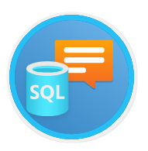

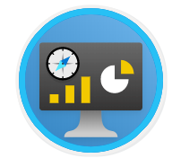
Agenda
Explore core data concepts
Explore roles and responsibilities in the world of data (optional)
Describe concepts of relational data
Explore concepts of non-relational data
Explore concepts of data analytics
Notes:
If you choose not to cover “Explore roles and responsibilities in the world of data” lesson, remove from this agenda slide and hide slides 11-17. This lesson is optional as it is not covered in the DP-900 exam objective domain and might cause this course to run long. Students can learn this content by doing the self-paced module on Learn here https://docs.microsoft.com/learn/modules/explore-roles-responsibilities-world-of-data/. Additionally, this content is in the student handbook Skillpipe content.

Slide 8
Lesson 1: Explore core data concepts

Slide 9

Lesson 1 objectives
Identify how data is defined and stored
Identify characteristics of relational and non-relational data
Describe and differentiate data workloads
Describe and differentiate batch and streaming data
Notes:
Instructor notes
Ensure that all of your students fully understand the components and processes involved. This will be the focus of the module.

Slide 10
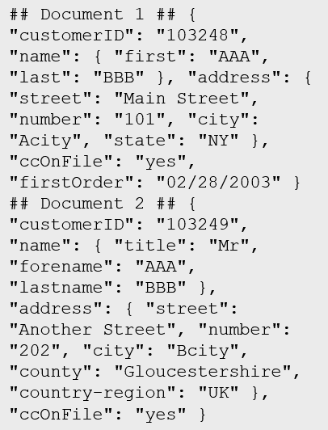
What is data?
Collection of facts, numbers, descriptions, objects , stored in a structured, semi-structured, unstructured way
Structured
Semi-structured
Unstructured
Table
Notes:
Instructor notes
Structured data is data that adheres to a schema, so all of the data has the same fields or properties. Structured data can be stored in a database table with rows and columns
Semi-structured data doesn't fit neatly into tables, rows, and columns. Instead, semi-structured data uses _tags_ or _keys_ that organize and provide a hierarchy for the data

Slide 11

Transactional vs analytical data stores
Online Transactional Processing (OLTP)
Online Analytical Processing (OLAP)
Customer
CustomerID | CustomerName | CustomerPhone
Orders
OrderID | CustomerID | OrderDate
Data is periodically loaded, aggregated and stored in a cube
Data is stored one transaction at a time
Notes:
Instructor notes
It is important to understand the distinction between OLTP and OLAP.
OLTP is typically a live system. Updates are made transactionally, for example, an order is placed. Each individual order is stored in the OLTP system.
OLAP is an aggregated system. Data is imported (often from an OLTP system) and aggregated. The aggregation will typically occur at different levels allowing you to drill down or up, for example from a company summary, to a department summary, to an employee town summary. Because OLAP data is aggregated periodically, once the aggregation has been performed, queries which need the summaries that it contains are very fast.
OLTP is good for many small updates that happen frequently. OLAP is good for large summarized queries that happen periodically.

Slide 12




Transactional workloads
Transactional data is information that tracks the interactions related to an organization's activities.
Atomicity – each transaction is treated as a single unit, which success completely or fails completely.
Consistency – transactions can only take the data in the database from one valid state to another.
Isolation – concurrent execution of transactions leave the database in the same state.
Durability – once a transaction has been committed, it will remain committed.
-$
+$

Slide 13



Analytical Workloads
Analytical workloads are used for data analysis and decision making.
Summaries
Trends
Business information
2020 Transactions
Notes:
Instructor notes
Analytical workloads are typically read-only systems that store vast volumes of historical data or business metrics
Analytics can be based on a snapshot of the data at a given point in time, or a series of snapshots.
An example of analytical information is a report on monthly sales.

Slide 14

Data Processing
Data processing is the conversion of raw data to meaningful information through a process.
Batch Processing: data elements are collected into a group. The whole group is then processed at a future time as a batch
Daily
Batch Job
All Input
All Output
Stream Processing: each new piece of data is processed when it arrives.
System Upload
System Upload
Input 1
Input 2
Notes:
Differences between batch and streaming
- *Data Scope*: Batch processing can process all the data in the dataset. Stream processing typically only has access to the most recent data received, or within a rolling time window (the last 30 seconds, for example).
- *Data Size*: Batch processing is suitable for handling large datasets efficiently. Stream processing is intended for individual records or *micro batches* consisting of few records.
- *Performance*: The latency for batch processing is typically a few hours. Stream processing typically occurs immediately, with latency in the order of seconds or milliseconds. Latency is the time taken for the data to be received and processed.
- *Analysis*: You typically use batch processing for performing complex analytics. Stream processing is used for simple response functions, aggregates, or calculations such as rolling averages.

Slide 15

Lesson 1: Knowledge check
How is data in a relational table organized?
Rows and Columns
Header and Footer
Pages and Paragraphs
Which of the following is an example of unstructured data?
An Employee table with columns Employee ID, Employee Name, and Employee Designation
Audio and Video files
A table within SQL Server database
What of the following is an example of a streaming dataset?
Data from sensor feeds
Sales data for the past month
List of employees working for a company

Slide 16
Lesson 2: Explore roles and responsibilities in the world of data
Notes:
If you choose not to cover “Explore roles and responsibilities in the world of data” lesson, remove from this agenda slide and hide slides 11-17. This lesson is optional as it is not covered in the DP-900 exam objective domain and might cause this course to run long. Students can learn this content by doing the self-paced module on Learn here https://docs.microsoft.com/learn/modules/explore-roles-responsibilities-world-of-data/. Additionally, this content is in the student handbook Skillpipe content.

Slide 17


Lesson 2 objectives
Explore data job roles
Explore common tasks and tools for data job roles
Notes:
Instructor notes
Ensure that all of your students fully understand the components and processes involved. This will be the focus of the module.

Slide 18


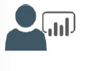
Roles in data
Database Administrator
Data Engineer
Data Analyst
Database Management
Implements Data Security
Backups
User Access
Monitors performance
Data Pipelines and processes
Data Ingestion storage
Prepare data for Analytics
Prepare data for analytical processing
Provides insights into the data
Visual Reporting
Modeling Data for Analysis
Combines data for visualization and analysis
Notes:
Instructor notes
Discuss the three roles that are listed, but consider that in real-world scenarios, actual job roles might be a combination of these roles, or a subset of a single role, based on the size of the organization.

Slide 19
Common tools – Database administrator
Azure Data Studio
SQL Server Management Studio
Azure Portal/CLI
Graphical interface for managing on-premises and cloud-based data services
Runs on Windows, macOS, Linux
Graphical interface for managing on-premises and cloud-based data services
Runs on Windows
Comprehensive Database Administration tool
Tools for management and provisioning of Azure Data Services
Manual and automation of scripts using Azure Resource Manager or Command Line Interface scripting
Notes:
Instructor notes
If you have time, show the tools, particularly the differences between Azure Data Studio and SQL Server Management Studio.
Key advantage of Azure Data Studio is that it is multi-platform.

Slide 20
Common tools – Data engineering
Azure Synapse Studio
SQL Server Management Studio
Azure Portal/CLI
Azure Portal integrated to manage Azure Synapse
Data Ingestion (Azure Data Factory)
Management of Azure Synapse assets (SQL Pools/Spark Pool)
Graphical interface for managing on-premises and cloud-based data services
Runs on Windows
Comprehensive Database Administration tool
Tools for management and provisioning of Azure resources
Manual and automation of scripts using Azure Resource Manager or Command Line Interface scripting

Slide 21
Common tools – Data analyst
Power BI Desktop
Power BI Portal/ Power BI Service
Power BI Report Builder
Data Visualization tool
Model and Visualize Data
Management of Azure Synapse assets (SQL Pools/Spark Pool)
Authoring and management of Power BI reports
Authoring of Power BI dashboards
Share Reports/Datasets
Data Visualization tool for paginated reports
Model and Visualize paginated reports

Slide 22

Lesson 2: Knowledge check
Which one of the following tasks is a role of a database administrator?
Backing up and restoring databases
Creating dashboards and reports
Identifying data quality issues
Which of the following tools is a visualization and reporting tool?
SQL Server Management Studio
Power BI
SQL
Which one of the following roles is not a data job role?
Systems Administrator
Data Analyst
Database Administrator

Slide 23
Lesson 3: Describe concepts of relational data

Slide 24
Lesson 3 objectives
Explore the characteristics of relational data
Define tables, indexes, and views
Explore relational data workload services in Azure
Notes:
Instructor notes
Ensure that all of your students fully understand the components and processes involved. This will be the focus of the module.
This should be covered very briefly because the concepts will be covered in depth in Module 2.

Slide 25

Identify relational database use cases
IoT:
Although typically considered for non-relational, the data from IoT devices could be structured and consistent
Online transaction processing:
For example order systems that perform many small transactional updates
Data warehousing:
Large amounts of data can be imported from multiple sources and structured to enable high-performance queries

Slide 26
Tables
Customers
CustomerID | CustomerName | CustomerPhone
100 | Muisto Linna | XXX-XXX-XXXX
101 | Noam Maoz | XXX-XXX-XXXX
102 | Vanja Matkovic | XXX-XXX-XXXX
103 | Qamar Mounir | XXX-XXX-XXXX
104 | Zhenis Omar | XXX-XXX-XXXX
105 | Claude Paulet | XXX-XXX-XXXX
106 | Alex Pettersen | XXX-XXX-XXXX
107 | Francis Ribeiro | XXX-XXX-XXXX
Data is stored in a table
Table consists of rows and columns
All rows have same # of columns
Each column is defined by a datatype
Notes:
Instructor notes
The main characteristics of a relational database are:
- All data is tabular. Entities are modeled as tables, each instance of an entity is a row in the table, and each property is defined as a column.
- All rows in the same table have the same set of columns.
- A table can contain any number of rows.
- A primary key uniquely identifies each row in a table. No two rows can share the same primary key.
- A foreign key references rows in another, related table. For each value in the foreign key column, there should be a row with the same value in the corresponding primary key column in the other table.

Slide 27
Entities
Customers
CustomerID | CustomerName | CustomerPhone
100 | Muisto Linna | XXX-XXX-XXXX
101 | Noam Maoz | XXX-XXX-XXXX
102 | Vanja Matkovic | XXX-XXX-XXXX
103 | Qamar Mounir | XXX-XXX-XXXX
104 | Zhenis Omar | XXX-XXX-XXXX
105 | Claude Paulet | XXX-XXX-XXXX
106 | Alex Pettersen | XXX-XXX-XXXX
An entity is a representation of an item which can be physical (such as a customer or a product), or virtual (such as an order).
Entities are connected by relations enabling interaction. For example, a customer can place an order for a product
Notes:
Instructor notes
This is now normalized and there would also be a link to a SalesPerson table.

Slide 28
Normalization
Customers
CustomerID | CustomerName | CustomerPhone
100 | Muisto Linna | XXX-XXX-XXXX
101 | Noam Maoz | XXX-XXX-XXXX
102 | Vanja Matkovic | XXX-XXX-XXXX
103 | Qamar Mounir | XXX-XXX-XXXX
104 | Zhenis Omar | XXX-XXX-XXXX
105 | Claude Paulet | XXX-XXX-XXXX
106 | Alex Pettersen | XXX-XXX-XXXX
Orders
OrderID | CustomerName | CustomerPhone
AD100 | Noam Maoz | XXX-XXX-XXXX
AD101 | Noam Maoz | XXX-XXX-XXXX
AD102 | Noam Maoz | XXX-XXX-XXXX
AX103 | Qamar Mounir | XXX-XXX-XXXX
AS104 | Qamar Mounir | XXX-XXX-XXXX
AR105 | Claude Paulet | XXX-XXX-XXXX
MK106 | Muisto Linna | XXX-XXX-XXXX
Data is normalized to:
Reduce storage
Avoid data duplication
Improve data quality
Notes:
Instructor notes
1st Normal Form (1NF) – Each cell should only contain one value
2nd normal form (2NF) – Every non-key column depends upon the whole key
3rd Normal form (3NF) – Columns do not depend on any non-key columns
In the above example, in the Orders table, Customer Phone depends upon Customer Name which breaks 3NF. This is resolved on the next slide.

Slide 29

Relations
Customers
CustomerID | CustomerName | CustomerPhone
100 | Muisto Linna | XXX-XXX-XXXX
101 | Noam Maoz | XXX-XXX-XXXX
102 | Vanja Matkovic | XXX-XXX-XXXX
103 | Qamar Mounir | XXX-XXX-XXXX
104 | Zhenis Omar | XXX-XXX-XXXX
105 | Claude Paulet | XXX-XXX-XXXX
106 | Alex Pettersen | XXX-XXX-XXXX
Orders
OrderID | CustomerID | SalesPersonID
AD100 | 101 | 200
AD101 | 101 | 200
AD102 | 101 | 200
AX103 | 103 | 201
AS104 | 103 | 201
AR105 | 105 | 200
MK106 | 105 | 201
In a normalized database schema:
Primary Keys and Foreign keys are used to define relationships
No data duplication exists (other than key values in 3rd Normal Form (3NF)
Data is retrieved by joining tables together in a query
Notes:
Instructor notes
This is now normalized and there would also be a link to a SalesPerson table.

Slide 30
Indexes
Customers
CustomerID | CustomerName | CustomerPhone
100 | Muisto Linna | XXX-XXX-XXXX
101 | Noam Maoz | XXX-XXX-XXXX
102 | Vanja Matkovic | XXX-XXX-XXXX
103 | Qamar Mounir | XXX-XXX-XXXX
104 | Zhenis Omar | XXX-XXX-XXXX
105 | Claude Paulet | XXX-XXX-XXXX
106 | Alex Pettersen | XXX-XXX-XXXX
IDX-CustomerRegion
CustomerID | Region
100 | France
101 | Brazil
102 | Croatia
103 | Jordan
104 | Spain
105 | France
106 | USA
An index:
Optimizes search queries for faster data retrieval
Reduces the amount of data pages that need to be read to retrieve the data in a SQL Statement
Data is retrieved by joining tables together in a query
Notes:
Instructor notes
Use an analogy of a book index. Without the index, you would have to read the whole book every time you wanted to find something. The disadvantage of an index is that every time you update information in the book, you need to update the index.

Slide 31
View
Customers
CustomerID | CustomerName | CustomerPhone
100 | Muisto Linna | XXX-XXX-XXXX
101 | Noam Maoz | XXX-XXX-XXXX
102 | Vanja Matkovic | XXX-XXX-XXXX
103 | Qamar Mounir | XXX-XXX-XXXX
104 | Zhenis Omar | XXX-XXX-XXXX
105 | Claude Paulet | XXX-XXX-XXXX
106 | Alex Pettersen | XXX-XXX-XXXX
Orders
OrderID | CustomerID | SalesPersonID
AD100 | 101 | 200
AD101 | 101 | 200
AD102 | 101 | 200
AX103 | 103 | 201
AS104 | 103 | 201
AR105 | 105 | 200
MK106 | 105 | 201
DB205 | 100 | 205
Create the definition of a view:
CREATE VIEW vw_customerorders AS
SELECT Customers.CustomerID, Customers.CustomerName, Orders.OrderID FROM Customers JOIN Orders on Customers.CustomerID = Orders.CustomerID
Retrieve the orders placed by customer 102 using the view:
SELECT CustomerName, OrderID from vw_customerorders WHERE CustomerID=102
A view is a virtual table based on the result set of query:
Views are created to simplify the query
Combine relational data into a single pane view
Notes:
Instructor notes
Views don’t contain data, they just define how it is displayed.

Slide 32
Lesson 3: Knowledge check
Which one of the following statements is a characteristic of a relational database?
All data must be stored as character strings
A row in a table represents a single entity
Different rows in the same table can contain different columns
What is an index?
A structure that enables you to locate rows in a table quickly, using an indexed value
A virtual table based on the result set of a query
A structure comprising rows and columns that you use for storing data

Slide 33
Lesson 4: Explore concepts of non-relational data

Slide 34
Lesson 4 objectives
Explore the characteristics of non-relational data
Define types of non-relational data
Describe NoSQL, and the types of non-relational databases
Notes:
Instructor notes
This should be covered very briefly because the concepts will be covered in depth in Module 3. Do not go into much more detail than what is presented on slide.

Slide 35
Explore characteristics of non-relational data
Entities
## Customer 1 ID: 1
Name: Mark Hanson
Telephone: [ Home: 1-999-9999999, Business: 1-888-8888888, Cell: 1-777- 7777777 ]
Address: [ Home: 121 Main Street, Some City, NY, 10110,
Business: 87 Big Building, Some City, NY, 10111 ]
## Customer 2 ID: 2
Title: Mr
Name: Jeff Hay
Telephone: [ Home: 0044-1999-333333, Mobile: 0044-17545-444444 ]
Address: [ UK: 86 High Street, Some Town, A County, GL8888, UK,
US: 777 7th Street, Another City, CA, 90111 ]
Non-relational collections can have:
Multiple entities in the same collection or container with different fields
Have a different, non-tabular schema
Are often defined by labeling each field with the name it represents
Notes:
Instructor notes
Data doesn’t follow rules of relational data.
Because data can be loaded in its native form, it can be loaded quickly.
Very flexible and good for unknown data or queries.
Less good for known data structures and known queries.

Slide 36
Identify non-relational database use cases
IoT and Telematics:
Often require to ingest large amounts of data in frequent burst of activity, data is either semi structured or structured, often requires real time processing
Retail and Marketing:
Common scenarios for globally distributed data, document storage
Gaming:
In-game stats, social media integration, leaderboards, low-latency applications
Web and Mobile:
Commonly used with web click analytics, modern applications including bots

Slide 37
Types of non-relational data
What is semi-structured data?
Data structure is defined within the actual data by fields. Format/file types include:
JSON
AVRO
ORC
Parquet
Notes:
Instructor notes
A JSON document is enclosed in curly brackets ({ and }). Each field has a name (a label), followed by a colon, and then the value of the field. Fields can contain simple values, or subdocuments (each starting and ending with curly brackets). Fields can also have multiple values, held as arrays and surrounded with square brackets ([ and ]).
Avro is a row-based format. It was created by Apache. Each record contains a header that describes the structure of the data in the record. This header is stored as JSON. The data is stored as binary information. An application uses the information in the header to parse the binary data and extract the fields it contains. Avro is a very good format for compressing data and minimizing storage and network bandwidth requirements.
ORC (Optimized Row Columnar format) organizes data into columns rather than rows. It was developed by HortonWorks for optimizing read and write operations in Apache Hive. Hive is a data warehouse system that supports fast data summarization and querying over very large datasets.
Parquet is another columnar data format. It was created by Cloudera and Twitter. A Parquet file contains row groups. Data for each column is stored together in the same row group. Each row group contains one or more chunks of data. A Parquet file includes metadata that describes the set of rows found in each chunk.

Slide 38
What is unstructured data?
Does not naturally contain fields:
Examples: video, audio, media streams, documents
Often used to extract data organization and categorize or identify “structures”
Frequently used in combination with Machine Learning or Cognitive Services capabilities to “extract data” by using:
Text Analytics
Sentiment Analysis with Cognitive APIs
Vision API

Slide 39
What is NoSQL?
Loose term, to describe non-relational
Key-value stores
Document based
Column family databases
Graph Databases
Notes:
Instructor notes
Key value store. Each data item in a key-value store has two elements, a key and a value. The key uniquely identifies the item, and the value holds the data for the item.
A document database represents the opposite end of the NoSQL spectrum from a key-value store.
In a document database, each document has a unique ID, but the fields in the documents are transparent to the database management system.
Document databases typically store data in JSON format, as described in the previous unit, or they could be encoded using other formats such as XML, YAML, JSON, BSON.
Documents could even be stored as plain text.
A column family database organizes data into rows and columns. Examples of this structure include ORC and Parquet files, described in the previous unit.
Graph databases are discussed in subsequent slides.

Slide 40

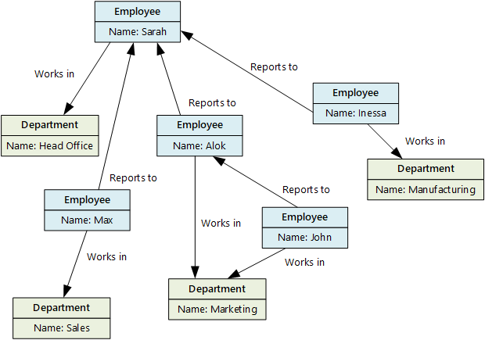

What is a graph database?
Stores entities centric around relationships
Enables applications to perform queries traversing a network of nodes and edges
Notes:
Instructor notes
Graph databases enable you to store entities, but the main focus is on the relationships that these entities have with each other. A graph database stores two types of information: nodes that you can think of as instances of entities, and edges, which specify the relationships between nodes.
Business requirements:
OLTP apps with highly correlated data
Easy updates to single or many objects
Flexible data modelling
Data requirements that evolve
Hierarchical data structures

Slide 41
Lesson 4: Knowledge check
Which of the following services should you use to implement a non-relational database?
Azure Cosmos DB
Azure SQL Database
The Gremlin API
Which of the following is a characteristic of non-relational databases?
Non-relational databases contain tables with flat fixed-column records
Non-relational databases require you to use data normalization techniques to reduce data duplication
Non-relational databases are either schema free or have relaxed schemas
You are building a system that monitors the temperature throughout a set of office blocks, and sets the air conditioning in each room in each block to maintain a pleasant ambient temperature. Your system has to manage the air conditioning in several thousand buildings spread across the country or region, and each building typically contains at least 100 air-conditioned rooms. What type of NoSQL data store is most appropriate for capturing the temperature data to enable it to be processed quickly?
A key-value store
A column family database
Write the temperatures to a blob in Azure Blob storage

Slide 42
Lesson 5: Explore concepts of data analytics

Slide 43

Lesson 5 objectives
Learn about data ingestion and processing
Explore data visualization
Explore data analytics
Notes:
Instructor notes
This should be covered very briefly because the concepts will be covered in depth in Module 2. Do not go into much more detail than what is presented on slide.

Slide 44






The Data Journey
Data Ingestion
Data Processing
Data Visualization
The process of obtaining and importing data for immediate use or storage in a database
Takes the data in its raw form, cleans it, and converts it into a more meaningful format
Query the data and create graphical representations of information and data
ETL
Extract, Transform, and Load
IoT Devices
Queries
Financial Transactions
ELT
Extract, Load, and Transform
Point-of-Sale
Data
Visualizations
Notes:
Ingestion is the process of importing data which might come in the form of a stream or in batches.
Data processing takes the data in its raw form, cleans it, and converts it into a more meaningful format.
ETL stands for *Extract, Transform, and Load*. The raw data is retrieved and transformed before being saved. The extract, transform, and load steps can be performed as a continuous pipeline of operations. It is suitable for systems that only require simple models, with little dependency between items.
The data processing engine can take an iterative approach, retrieving and processing the data from storage, before writing the transformed data and models back to storage. ELT (Extract, Load and Transform) is more suitable for constructing complex models that depend on multiple items in the database, often using periodic batch processing.
Data visualization is the graphical representation of information and data.

Slide 45



Data visualization
A business model can contain an enormous amount of information – there are techniques to analyze and understand the information in your models
Reporting
Business intelligence (BI)
Data visualization
Notes:
Reporting: Process of organizing data into informational summaries to monitor how different areas of an organization are performing. Reporting shows you what has happened, while analysis focuses on explaining why it happened and what you can do about it.
Business Intelligence: Refers to technologies, applications, and practices for the collection, integration, analysis, and presentation of business information. Business intelligence systems provide historical, current, and predictive views of business operations, most often using data that has been gathered into a data warehouse, and occasionally working from live operational data.
Data Visualization: Is the graphical representation of information and data. By using visual elements like charts, graphs, and maps, data visualization tools provide an accessible way to spot and understand trends, outliers, and patterns in data.

Slide 46
Explore data analytics
Descriptive
Diagnostic
Predictive
Prescriptive
Cognitive
Notes:
Instructor notes
Descriptive Analytics
The world of analytics, is evolving from the typical “Descriptive Analytics”, which is all about – What is happening in my business?
Diagnostic Analytics
The data insights, provided by descriptive analytics, are needed to provide the answer to: , “Why it is happening in your business”, which is often referred to analyzing root cause, or “Diagnostic Analytics”
Both, Descriptive and Diagnostic Analytics, is seen as a workload which is primarily providing a reactive response --- from what is happening, why is it happening, to what I am I going to do about it?
Predictive Analytics
By building out predictive patterns on top of your data, by utilizing the data findings from Descriptive, Diagnostic and Predictive data, you’ll be able to identify what is based on what you get from descriptive and diagnostic analytics and used to find answers to the question of what is likely to happen in the future based on previous trends and patterns?
Prescriptive Analytics
Techniques used to provide a predictive insights into your data, is commonly introduced by building out machine learning models, to “predict” trends and give the answer to the very
When you get the findings from Descriptive, Diagnostic and Predictive analytics like what’s happened, the root cause behind that and what-might-happen in future, Prescriptive model utilizes those answers to help you determine the best course of action to choose to bypass or eliminate future issues.
Cognitive Analytics
Cognitive analytics combines a number of intelligent technologies like artificial intelligence, machine-learning algorithms, deep learning etc.to apply human brain like intelligence to perform certain tasks. Basically, this type of analytics is inspired by how the human brain processes information, draws conclusions and codifies instincts and experience into learning such as understanding not only the words in a text but the full context of what is being written or spoken.

Slide 47

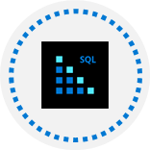
Lesson 5: Knowledge check
What is data ingestion?
The process of transforming raw data into models containing meaningful information
Analyzing data for anomalies
Capturing raw data streaming from various sources and storing it
Which one of the following visuals displays the major contributors to a selected result or value?
Key influencers
Column and bar chart
Matrix chart
Which type of analytics helps answer questions about what has happened in the past?
Descriptive analytics
Prescriptive analytics
Predictive analytics

Slide 48
Closing slide

Slide 49
Module 2: Explore relational data in Azure

Slide 50



Agenda
Explore relational data services in Azure
Explore provisioning and deploying relational database services in Azure
Query relational data in Azure

Slide 51

Lesson 1: Explore relational data services in Azure

Slide 52

Lesson 1 objectives
What are Azure Data Services?
IaaS vs PaaS
SQL Server on Azure virtual machines
Azure SQL DB
PostgreSQL, MySQL, MariaDB
Notes:
Instructor notes
Ensure that all of your students fully understand the components and processes involved. This will be the focus of the module.

Slide 53




What are Azure Data Services?
Notes:
Azure offers a range of options for running a database management system in the cloud.
Azure Data Services fall into the PaaS category. These services are a series of DBMSs managed by Microsoft in the cloud. Each data service takes care of the configuration, day-to-day management, software updates, and security of the databases that it hosts. All you do is create your databases under the control of the data service.
Azure Data Services are available for several common relational database management systems. The most well-known service is Azure SQL Database. The others currently available are Azure Database for MySQL servers, Azure Database for MariaDB servers, and Azure Database for PostgreSQL servers.

Slide 54
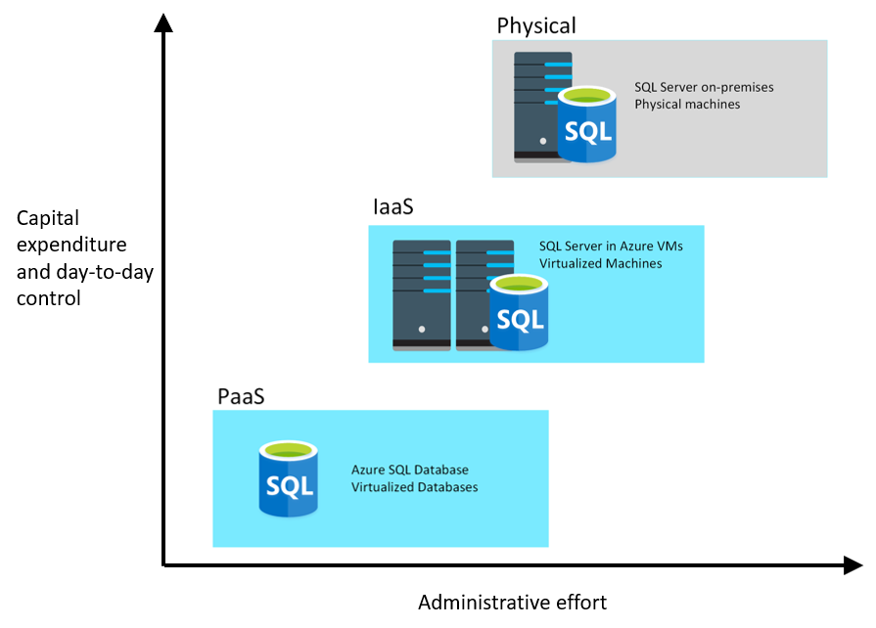
IaaS vs PaaS
Notes:
Instructor notes
Point out that if you don’t need the additional control, you can save on capital expenditure and administrative effort.
Talk through the points on the next 5 slides. All of the key points are on the slides.

Slide 55


SQL Server on Azure
SQL Server on Azure Virtual Machines
Azure SQL Managed Instance
Azure SQL Database
Infrastructure as a Service
Platform as a Service
Notes:
Azure offers a range of options for running SQL Server in the cloud.
For example, you can migrate your on-premises systems to a collection of Azure virtual machines. This approach still requires that you manage your DBMS carefully (SQL Server on Azure VM).
Alternatively, you can take advantage of the various Azure relational data services available. These data services manage the DBMS for you, leaving you free to concentrate on the data they contain and the applications that use them (Azure SQL Managed Instance and Azure SQL Database).

Slide 56



SQL Server on Azure Virtual Machines
SQL Server on Virtual Machines is an IaaS solution that enables users to use full versions of SQL Server in the Cloud without having to manage any on-premises hardware.
Guaranteed compatibility to SQL Server on premises
Customer manages everything – OS upgrades, software upgrades, backups, replication
Pay for the server and licensing, not per database

Slide 57
Azure SQL Database
Azure SQL Database is a PaaS offering where users create a managed database server in the cloud, and then deploy the databases on the server.
Low-cost option with minimal administration
Best for new cloud projects with flexible application design
Supports systems with variable loads – scale up and down quickly without restarting
Single Database
Elastic Pool
Create and run a database server in the cloud and access the database through the server.
Multiple databases share the same resources, such as memory, storage, and processing power.

Slide 58

Azure SQL Managed Instance
Azure SQL Managed Instance allows you to pre-provision compute resources and deploy several individual managed instances up to your pre-provisioned compute level.
Automatic backups, software patching, database monitoring, and other administrative tasks
Near 100% compatibility with on-premises SQL Server
Supported by other Azure services
Single Instance
Instance Pool
One SQL Server instance, multiple databases.
Multiple instances share the same resources.

Slide 59
Azure SQL Managed Instance or Azure SQL Database
Azure SQL Managed Instance
Azure SQL Database
Single instance:
SQL Server surface area (vast majority)
Native virtual network support
Fully managed service
Instance pool:
Pre-provision compute resources for migration
Enables cost-efficient migration
Ability to host smaller instances (2Vcore)
Currently in public preview
Single database:
Hyperscale storage (up to 100TB)
Serverless compute
Fully managed service
Elastic pool:
Resource sharing between multiple databases to price optimize
Simplified performance management for multiple databases
Fully managed service

Slide 60
PostgreSQL, MySQL, MariaDB
Azure Database for PostgreSQL is a relational database service in the Microsoft cloud based on the PostgreSQL Community Edition database engine.
Azure Database for MySQL is a PaaS implementation of MySQL in the Azure cloud, based on the MySQL Community Edition.
Azure Database for MariaDB is an implementation of the MariaDB database management system adapted to run in Azure. It's based on the MariaDB Community Edition.
Notes:
Instructor notes
PostgreSQL is a hybrid relational-object database. You can store data in relational tables, but a PostgreSQL database also enables you to store custom data types, with their own non-relational properties.
MySQL started life as a simple-to-use open-source database management system. It is the leading open source relational database for *Linux, Apache, MySQL, and PHP* (LAMP) stack apps.
MariaDB is a newer database management system, created by the original developers of MySQL. The database engine has since been rewritten and optimized to improve performance. MariaDB offers compatibility with Oracle Database (another popular commercial database management system).

Slide 61
Benefits of Azure Database for PostgreSQL, MySQL, MariaDB
Fully managed community database:
Take advantage of a fully managed service while still using the tools and languages you’re familiar with
Built-in high availability for lowest TCO:
Ensure your data is always available without the need for additional costs
Intelligent performance and scale:
Improve performance with built-in intelligence and up to 16TB storage and 20K IOPs
Industry-leading security and compliance:
Protect your data with enhanced security features including Advanced Threat Protection
Integration with the Azure ecosystem:
Build apps faster with Azure services and safeguard your innovation with Azure IP Advantage
Notes:
Instructor notes
Point out that you get these benefits because of Azure. For example, Azure Database for MySQL is based on the Community edition, which does not have high availability, but Azure Database for MySQL has high availability because it runs in Azure.

Slide 62
Lesson 1: Knowledge check (continued on next slide)
Which deployment requires the fewest changes when migrating an existing SQL Server on-premises solution?
Azure SQL Database Managed Instance
SQL Server running on a virtual machine
Azure SQL Database Single Database
Which of the following statements is true about SQL Server running on a virtual machine?
You must install and maintain the software for the database management system yourself, but backups are automated
Software installation and maintenance are automated, but you must do your own backups
You’re responsible for all software installation and maintenance, and performing back ups
Which of the following statement is true about Azure SQL Database?
Scaling up doesn’t take effect until you restart the database
Scaling out doesn’t take effect until you restart the database
Scaling up or out will take effect without restarting the SQL database

Slide 63
Lesson 1: Knowledge check (continued)
When using an Azure SQL Database managed instance, what is the simplest way to implement backups?
Manual Configuration of the SQL server
Create a scheduled task to back up
Backups are automatically handled
What is the best way to transfer the data in a PostgreSQL database running on-premises into a database running Azure Database for PostgreSQL service?
Export the data from the on-premises database and import it manually into the database running in Azure
Upload a PostgreSQL database backup file to the database running in Azure
Use the Azure Database Migration Services

Slide 64
Lesson 2: Explore provisioning and deploying relational database services in Azure

Slide 65
Lesson 2 objectives
Provision relational data services
Configure relational data services
Explore basic connectivity issues
Explore data security
Notes:
Instructor notes
Ensure that all of your students fully understand the components and processes involved. This will be the focus of the module.

Slide 66
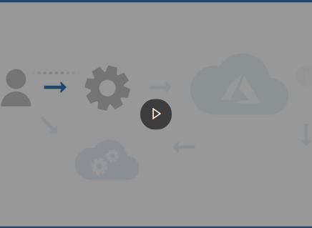
Demo: What is provisioning?
This video summarizes the process that Azure performs when you provision a service
Notes:
Instructor notes
NOTE: this demo is duplicated in Module 3 Lesson 2 so only demo once.
Link: https://www.microsoft.com/videoplayer/embed/RE4zTud

Slide 67
Configure relational data services
Basics
Network connectivity
Additional settings
Tags (DB)
Review & create
Subscription
Resource group
Managed Instance/ Server name
Database Name (DB)
Admin Login
Password
Region
Opt-in for pools (DB)
Compute + storage
Public vs Private access
VNet/Firewall rules
Connection type (MI)
Data source (DB)
Server Collation (MI)
Database Collation (DB)
Time zone (MI)
Opt-in for Advanced data security (DB)
Terms and Privacy
Notes:
Instructor notes
For a production deployment, you should consider all settings for every deployment.

Slide 68
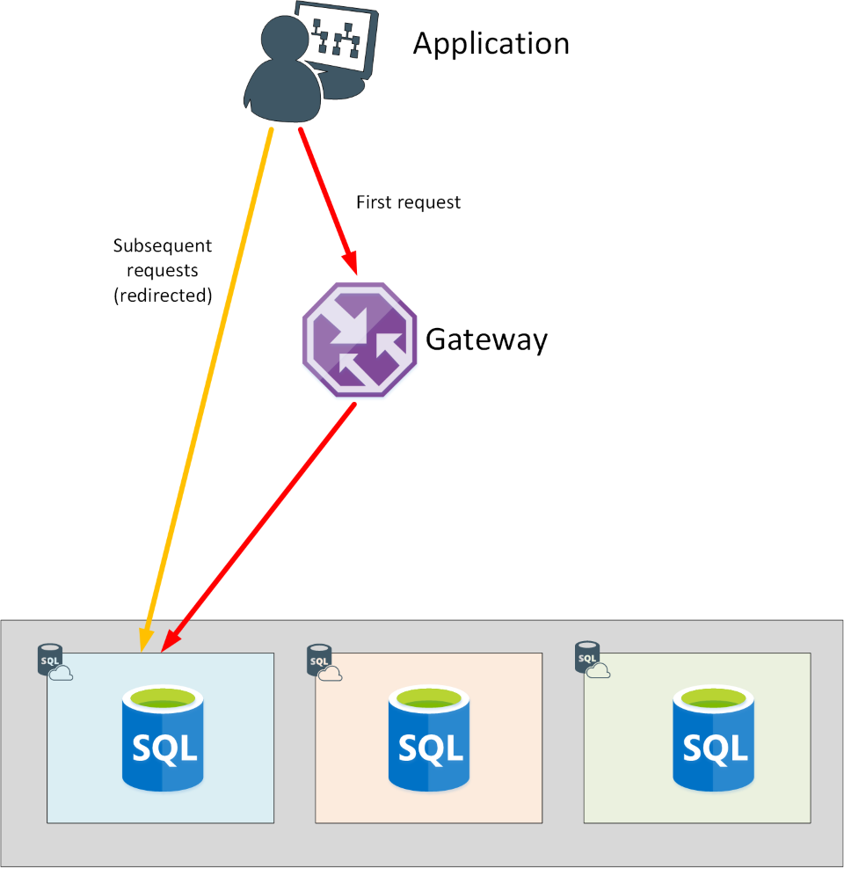
Connectivity from within Azure
Policy of Redirect
An application establishes a connection to the Azure SQL database through the gateway
All requests after the first, will go directly to the database
If connectivity to the database fails, the application will have to reconnect through the gateway.
The application may be directed to a different copy of the database running on another server in the cluster.
Notes:
Instructor notes
https://docs.microsoft.com/en-us/azure/sql-database/sql-database-connectivity-architecture

Slide 69
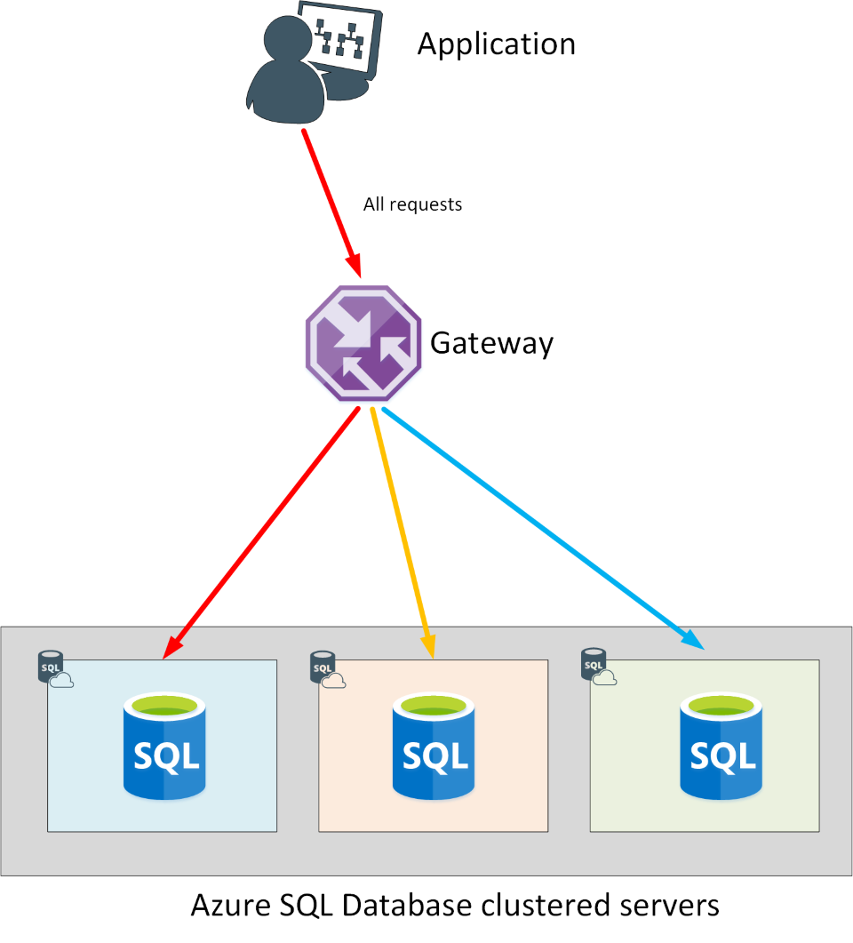
Connectivity from outside of Azure
Policy of Proxy
An application establishes a connection to the Azure SQL database via the gateway
All requests will go through the gateway
The application may be directed to a different copy of the database running on another server in the cluster.

Slide 70
Authentication and Access Control
“Mixed Mode” authentication forced
SQL Auth for deployment: server admin:
Server-level principal for logical server for DB
Member of sysadmin server role for MI
Need Windows Auth? Use Azure AD Authentication Azure Managed Instance:
Azure AD Server Admin
SQL or Azure AD Logins
Database Users
SQL Server Contained Database supported
Azure SQL Database:
Azure AD Server Admin
SQL logins
loginmanager and dbmanager roles for limited server admins
Database Users
Contained Database Users including Azure AD (recommended)

Slide 71
Azure Role Based Access Control (RBAC)
Azure Role Based Access Control (RBAC) helps you manage who has access to Azure resources, and what they can do with those resources.
You control access to resources using role assignments. A role assignment consists of three elements:
Security principal: an object that represents a user or service that is requesting access to Azure resource
Role: a collection of permissions
Scope: A lists the set of resources that the access applies to
Notes:
SQL DB Contributor – Can create and manage database but access the database (Ex. to connect and read data)
SQL Managed Instance Contributor – Create and manage managed instances but can't give access to others.
SQL Security Manager - Manage security policies for MI and databases (like auditing) but not access the MI or database
SQL Server Contributor – Manage servers and databases but not access them.

Slide 72
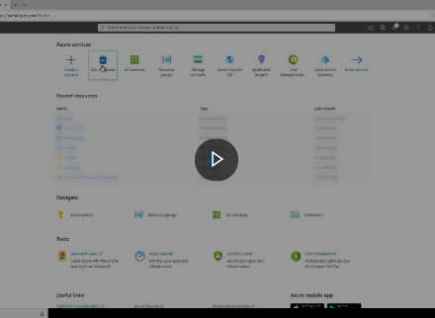
Demo: Provision an Azure SQL Database instance
This video demonstrates how to provision an Azure SQL Database instance, to create a database and server
Notes:
Link: https://www.microsoft.com/videoplayer/embed/RE4AkhG

Slide 73
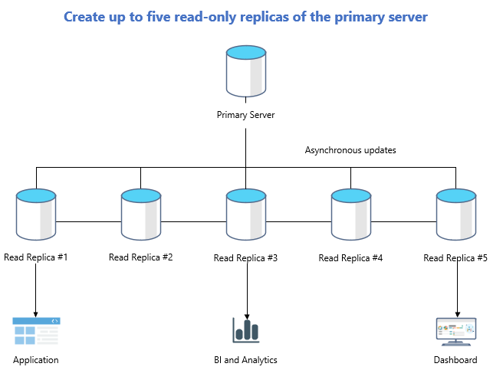
Azure DB – Read replicas
Read replicas help improve performance and scale of read-intensive workloads such as BI and analytics
Consider the read replica features in scenarios when delays in synching data between the primary and replicas are acceptable
Create a replica in a different Azure region from the primary for a disaster recovery plan, where a replica replaces the primary in cases of regional disasters
Data storage on replica servers grows automatically without impacting workloads

Slide 74
Lab: Provision Azure relational database service
As part of your role at Contoso as a data engineer, you’ve been asked to create and configure SQL Server, PostgreSQL, and MySQL servers for Azure
Go to the exercise Provision non-relational Azure data services module on Microsoft Learn, and follow the instructions in the module to create data stores
Notes:
Link: https://docs.microsoft.com/en-us/learn/modules/explore-provision-deploy-relational-database-offerings-azure/7-exercise-provision-relational-azure-data-services?pivots=postgresql
Create data stores:
A Cosmos DB for holding information about the volume of items in stock. You need to store current and historic information about volume levels, so you can track how levels vary over time. The data is recorded daily.
A Data Lake store for holding production and quality data.
A blob container for holding images of the products the company manufactures.
File storage for sharing reports.

Slide 75
Lesson 3: Query relational data in Azure

Slide 76
Lesson 3 objectives
Query relational data
Describe query techniques for data using the SQL language
Notes:
Instructor notes
Ensure that all of your students fully understand the components and processes involved. This will be the focus of the module.

Slide 77
Introduction to SQL
SQL is a standard language for use with relational databases
SQL standards are maintained by ANSI and ISO
Proprietary RDBMS systems have their own extensions of SQL such as T-SQL, PL/SQL, pgSQL

Slide 78
SQL Statement types
DML
DDL
DCL
Data Manipulation Language
Used to query and manipulate data
SELECT, INSERT, UPDATE, DELETE
Data Definition Language
Used to define database objects
CREATE, ALTER, DROP, RENAME
Data Control Language
Used to manage security permissions
GRANT, REVOKE, DENY
Notes:
Instructor notes
Explain that DML statements are by far the most common.

Slide 79
Use DML statements
Statement | Description
SELECT | Select/read from a table
INSERT | Insert new rows in a table
UPDATE | Edit/Update existing rows in a table
DELETE | Delete existing rows in a table
Notes:
Instructor notes

Slide 80
Elements of the SELECT Statement
Clause | Expression
SELECT | <select list>
FROM | <table or view>
WHERE | <search condition>
GROUP BY | <group by list>
ORDER BY | <order by list>
Notes:
Instructor notes
Explain that SQL is not procedural. It processes the FROM first, followed by WHERE, GROUP BY, ORDER BY, and finally SELECT.
20761C
3: Writing SELECT Queries

Slide 81
Example of SELECT statement
SELECT EmployeeId, YEAR(OrderDate) AS OrderYear
FROM Sales.Orders
WHERE CustomerId = 71
GROUP BY EmployeeId, YEAR(OrderDate)
HAVING COUNT(*) > 1
ORDER BY EmployeeId, OrderYear;

Slide 82
Example of INSERT statement
The INSERT ... VALUES statement inserts a new row
INSERT INTO Sales.OrderDetails
(orderid, productid, unitprice, qty, discount)
VALUES (10255,39,18,2,0.05);
Table and row constructors add multirow capability to INSERT ... VALUES
INSERT INTO Sales.OrderDetails
(orderid, productid, unitprice, qty, discount)
VALUES
(10256,39,18,2,0.05),
(10258,39,18,5,0.10);
Notes:
Instructor notes
Note that some words are optional and you might see the word INTO omitted.
20761C
7: Using DML to Modify Data

Slide 83
Use DDL statements
Statement | Description
CREATE | Create a new object in the database, such as a table or a view
ALTER | Modify the structure of an object. For instance, altering a table to add a new column.
DROP | Remove an object from the database.
RENAME | Rename an existing object.
Notes:
Instructor notes
You use DDL statements to create, modify, and remove tables and other objects in a database (table, stored procedures, views, and so on).
These are the most common DDL statements: CREATE ALTER, DROP, and RENAME.
WARNING: The DROP statement is very powerful. When you drop a table, all the rows in that table are lost. Unless you have a backup, you won't be able to retrieve this data.

Slide 84
Example of CREATE statement
CREATE TABLE Mytable
(Mycolumn1 int NOT NULL PRIMARY KEY, Mycolumn2 VARCHAR(50) NOT NULL , Mycolumn3 VARCHAR(10) NOT NULL

Slide 85
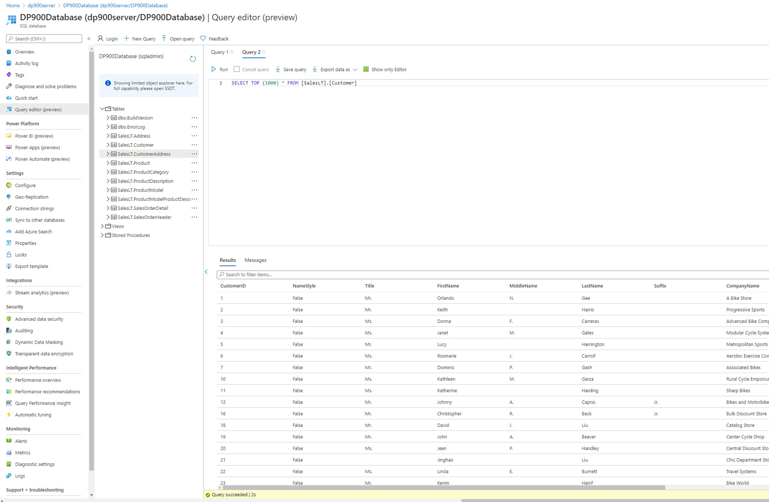
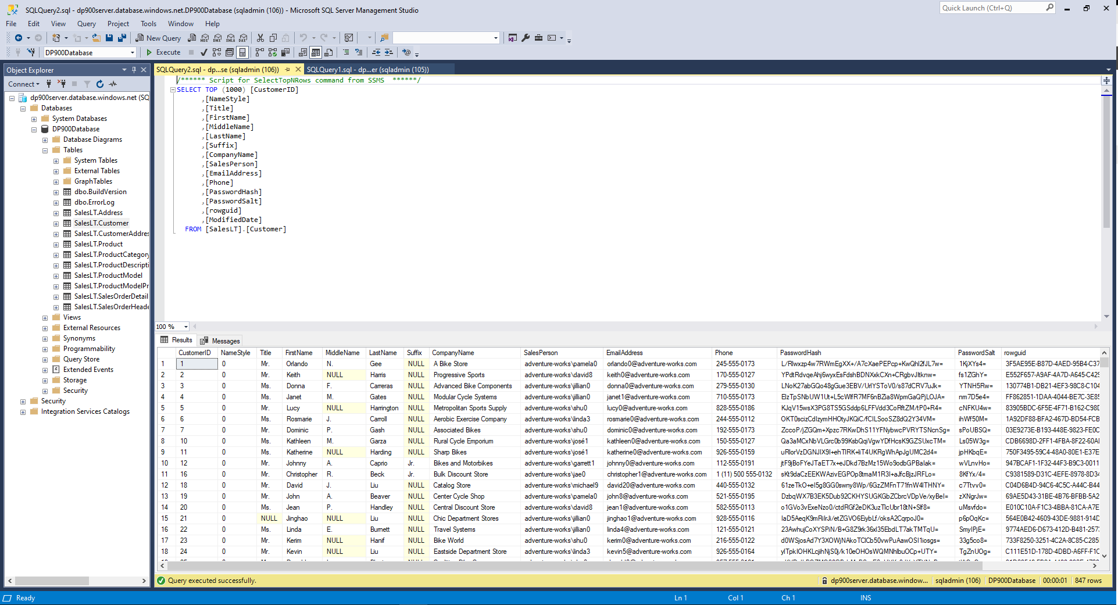
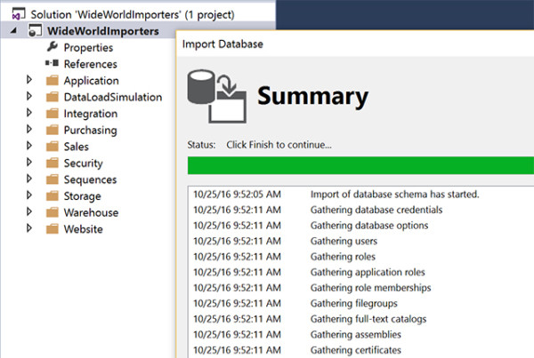
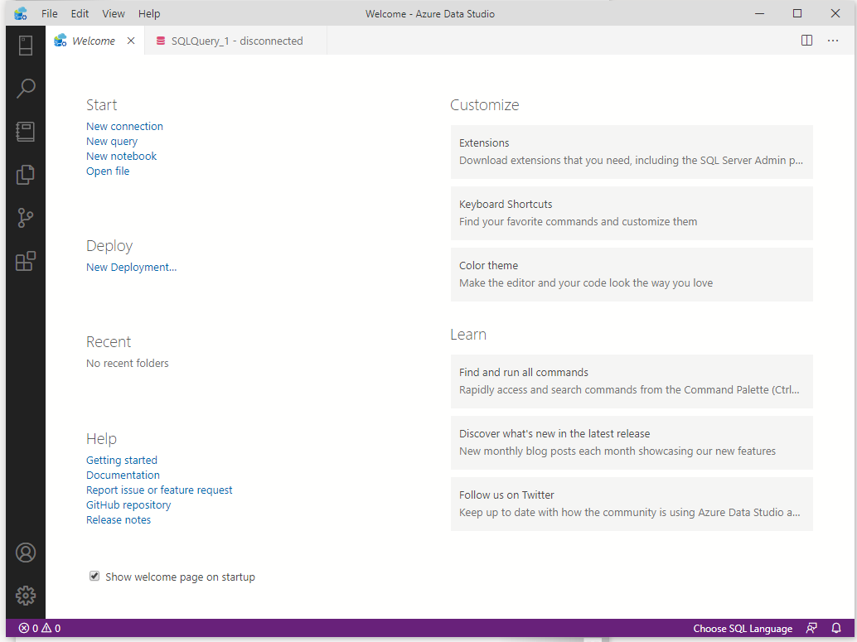
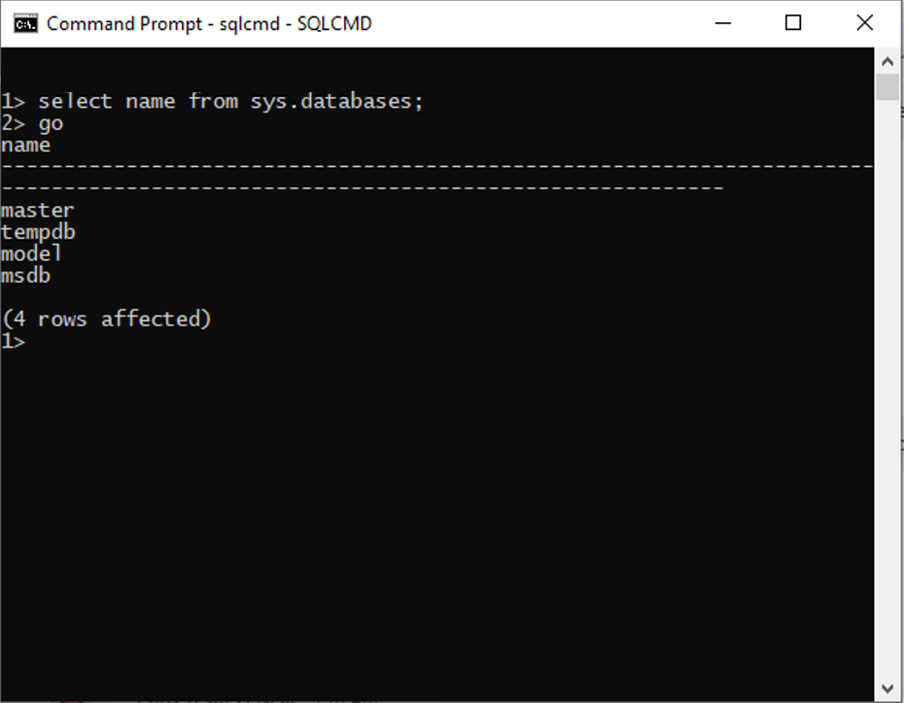
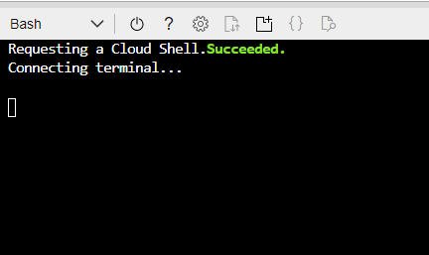
Query tools
Azure portal
SQL Management Studio
SQL Server Data Tools
Azure Data Studio
SQLCMD
Azure CLI/Cloud Shell
Notes:
Instructor notes
These are all tools that will accept SQL statements.

Slide 86
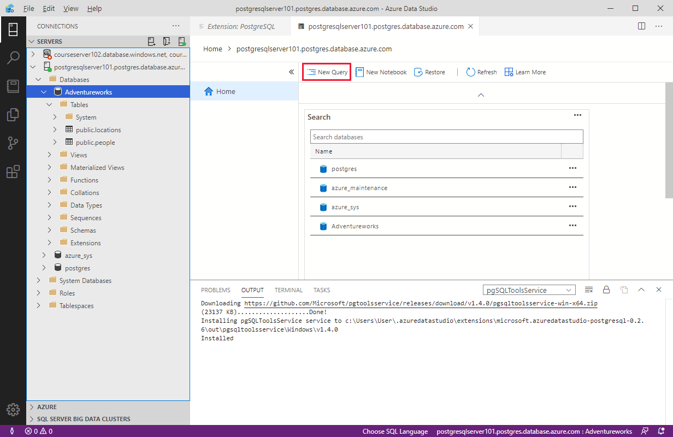
Query relational data in Azure Database for PostgreSQL
Use PSQL to query a database
Azure Cloud Shell
Azure Data Studio
psql --host=<server-name>.postgres.database.azure.com --username=<admin-user>@<server-name> --dbname=postgres
CREATE DATABASE "Adventureworks";
CREATE TABLE PEOPLE(NAME TEXT NOT NULL, AGE INT NOT NULL);
INSERT INTO PEOPLE(NAME, AGE) VALUES ('Bob', 35);
INSERT INTO PEOPLE(NAME, AGE) VALUES ('Sarah', 28);
CREATE TABLE LOCATIONS(CITY TEXT NOT NULL, STATE TEXT NOT NULL);
INSERT INTO LOCATIONS(CITY, STATE) VALUES ('New York', 'NY’);
INSERT INTO LOCATIONS(CITY, STATE) VALUES ('Flint', 'MI');
SELECT * FROM PEOPLE;
SELECT * FROM LOCATIONS;
Notes:
Instructor notes
Note that, while SQL Server uses TSQL, PostgreSQL uses psql. It is similar, but not the same.

Slide 87
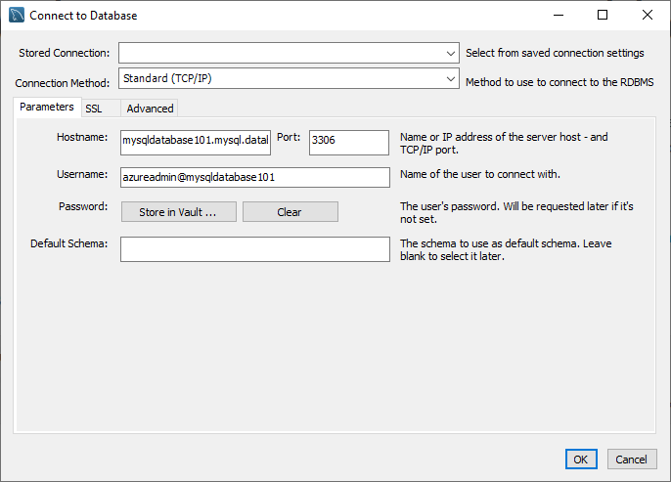
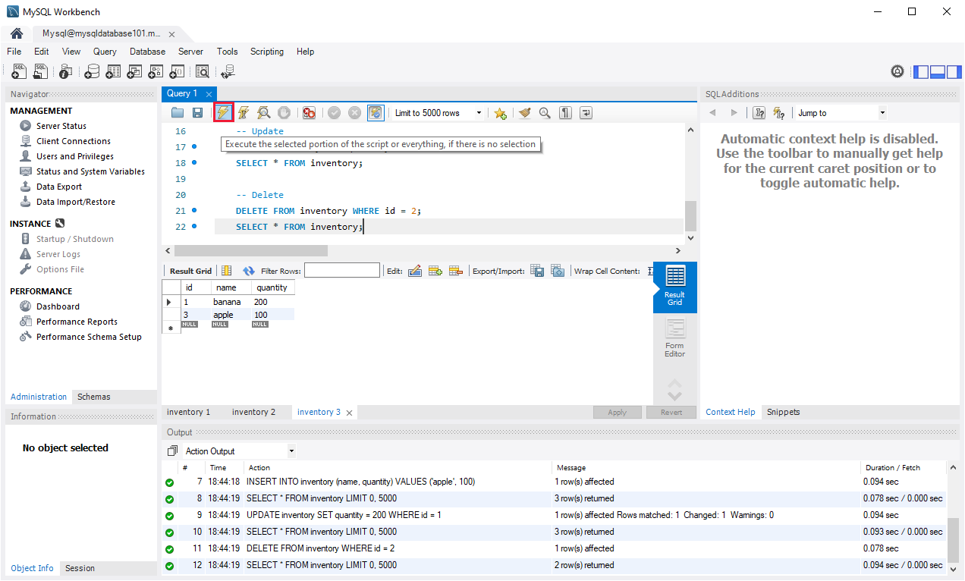
Query relational data in Azure Database for MySQL
Use MySQL Workbench to query a database

Slide 88
Lab: Use SQL to query Azure SQL Database
Contoso has provisioned the SQL database and has imported all the inventory data into the data store. As lead developer, you’ve been asked to run some queries over the data
Go to the exercise Use SQL to query Azure SQL Database module on Microsoft Learn, and follow the instructions to query the database to find how many products are in the database, and the number of items in stock for a particular product
Notes:
Link: https://docs.microsoft.com/en-us/learn/modules/query-relational-data/6-perform-query

Slide 89
Closing slide

Slide 90
Module 3: Explore non-relational data in Azure

Slide 91
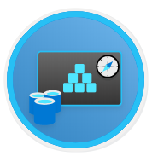

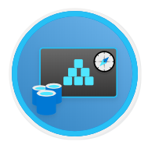
Agenda
Explore non-relational data services in Azure
Explore provisioning and deploying non-relational data services in Azure
Manage non-relational data stores in Azure

Slide 92
Lesson 1: Explore non-relational data services in Azure

Slide 93
Lesson 1 objectives
Explore use-cases and management benefits of using Azure Table storage
Explore use-cases and management benefits of using Azure Blob storage
Explore use-cases and management benefits of using Azure File storage
Explore use-cases and management benefits of using Azure Cosmos DB

Slide 94
Explore Azure Table storage
Key (Customer ID)
Value (Customer Data)
C1
AAAAA
BBB
101 Block Street
YY
999
888
C2
MM
NN
21 A Street
5 B Avenue
C3
DDD
EEE
FFF
111
222
66 C Road
Notes:
Instructor notes
All rows in a table must have a key, but apart from that the columns in each row can vary. Unlike traditional relational databases, Azure Table Storage tables have no concept of relationships, stored procedures, secondary indexes, or foreign keys. Data will usually be denormalized, with each row holding the entire data for a logical entity.

Slide 95
Explore Azure Blob storage
Block blobs
Page blobs
Append blobs
Has a maximum size of 4.7TB
Best for storing large, discrete, binary objects that changes infrequently
Each individual block can store up to 100MB of data
A block blob can contain up to 50000 blocks
Can hold up to 8TB of data
Is organized as a collection of fixed sized-512 byte pages
Used to implement virtual disk storage for virtual machines
The maximum size is just over 195GB
Is a block blob that is used to optimize append operations
Each individual block can store up to 4MB of data
Notes:
Instructor notes
Azure Blob storage is a service that enables you to store massive amounts of unstructured data, or Binary Large OBjects, in the cloud.
Azure currently supports three different types of blob:
Block blobs. A block blob is handled as a set of blocks. Each block can vary in size, up to 100 MB. A block blob can contain up to 50,000 blocks, giving a maximum size of over 4.7 TB. The block is the smallest amount of data that can be read or written as an individual unit. Block blobs are best used to store discrete, large, binary objects that change infrequently.
Page blobs. A page blob is organized as a collection of fixed size 512-byte pages. A page blob is optimized to support random read and write operations; you can fetch and store data for a single page if necessary. A page blob can hold up to 8 TB of data. Azure uses page blobs to implement virtual disk storage for virtual machines.
Append blobs. An append blob is a block blob optimized to support append operations. You can only add blocks to the end of an append blob; updating or deleting existing blocks isn't supported. Each block can vary in size, up to 4 MB. The maximum size of an append blob is just over 195 GB.

Slide 96






Explore Azure File storage
Azure File Storage creates files shares in the cloud and provides the ability to access the file shares from anywhere with an internet connection.
Uses Server Message Block 3.0 (SMB) to share files
Share up to 100 TB of data in a single storage account
Fully managed service – data is replicated locally and is encrypted at rest
File Share
Cloud Apps
On-Premises Apps
Cloud Apps

Slide 97

What is Azure Cosmos DB?
Azure Cosmos DB is a multi-model NoSQL database management system.
Cosmos DB manages data as a partitioned set of documents.
Real time access with fast read and write latencies.
Takes advantage of Azure scaling and storage capabilities.
Notes:
Relational databases store data in relational tables, but sometimes the structure imposed by this model can be too rigid, and often leads to poor performance unless you spend time implementing detailed tuning. Other models, collectively known as NoSQL databases exist. These models store data in other structures, such as documents, graphs, key-value stores, and column family stores.
Azure Cosmos DB is a multi-model NoSQL database management system.
Cosmos DB manages data as a partitioned set of documents. A document is a collection of fields, identified by a key.
The fields in each document can vary, and a field can contain child documents.
Many document databases use JSON (JavaScript Object Notation) to represent the document structure.
In this format, the fields in a document are enclosed between braces, { and }, and each field is prefixed with its name.
A document can hold up to 2 MB of data, including small binary objects.
If you need to store larger blobs as part of a document, use Azure Blob storage, and add a reference to the blob in the document.
Documents in a Cosmos DB database are organized into containers.
The documents in a container are grouped together into partitions. A partition holds a set of documents that share a common partition key.
You designate one of the fields in your documents as the partition key.
You should select a partition key that collects all related documents together.
This approach helps to reduce the amount of I/O (disk reads) that queries might need to perform when retrieving a set of documents for a given entity.
For example, in a document database for an ecommerce system recording the details of customers and the orders they've placed, you could partition the data by customer ID, and store the customer and order details for each customer in the same partition.
To find all the information and orders for a customer, you simply need to query that single partition.
There's a superficial similarity between a Cosmos DB container and a table in Azure Table storage: in both cases, data is partitioned and documents (rows in a table) are identified by a unique ID within a partition.
However, the similarity ends there. Unlike Azure Table storage, documents in a Cosmos DB partition aren't sorted by ID.
Instead, Cosmos DB maintains a separate index. This index contains not only the document IDs, but also tracks the value of every other field in each document.
This index is created and maintained automatically.
This index enables you to perform queries that specify criteria referencing any fields in a container, without incurring the need to scan the entire partition to find that data.

Slide 98
Use cases for Azure Cosmos DB
Web and retail
Gaming
IoT scenarios
Using Azure Cosmos DB’s multi-master replication model along with Microsoft’s performance commitments, Data Engineers can implement a data architecture to support web and mobile applications that achieve less than a 10-ms response time anywhere in the world
The database tier is a crucial component of gaming applications. Modern games perform graphical processing on mobile/console clients but rely on the cloud to deliver customized and personalized content like in-game stats, social media integration, and high-score leader boards
Hundreds of thousands of devices have been designed and sold to generate sensor data known as Internet of Things (IoT) devices. Using technologies like Azure IoT Hub, Data Engineers can easily design a data solution architecture that captures real-time data. Cosmos DB can accept and store this information very quickly
Notes:
Instructor notes
Use cases and management benefits of using Azure Cosmos DB
Cosmos DB is a highly scalable database management system. Each partition can grow up to 10 GB in size.
Indexes are created and maintained automatically.
All databases are replicated within a single region (or across regions at additional cost)
Cosmos DB guarantees 99.99% high availability.
Cosmos DB guarantees less than 10-ms latencies for both reads (indexed) and writes at the 99th percentile, all around the world.
Cosmos DB is highly suitable for the following scenarios:
- IoT and telematics - Retail and marketing
Gaming
Web and mobile applications

Slide 99
Lesson 1: Knowledge check (continued on next slide)
What are the elements of an Azure Table storage key?
Table name and column name
Partition key and row key
Row number
When should you use a block blob, and when should you use a page blob?
Use a block blob for unstructured data that requires random access to perform reads and writes. Use a page blob for discrete objects that rarely change.
Use a block blob for active data stored using the Hot data access tier, and a page blob for data stored using the Cool or Archive data access tiers
Use a page block for blobs that require random read and write access. Use a block blob for discrete objects that change infrequently
Why might you use Azure File storage?
To share files that are stored on-premises with users located at other sites
To enable users at different sites to share files
To store large binary data files containing images or other unstructured data

Slide 100
Lesson 1: Knowledge check (continued)
You are building a system that monitors the temperature throughout a set of office blocks, and sets the air conditioning in each room in each block to maintain a pleasant ambient temperature. Your system has to manage the air conditioning in several thousand buildings spread across the country/region, and each building typically contains at least 100 air-conditioned rooms. What type of NoSQL data store is most appropriate for capturing the temperature data to enable it to be processed quickly?
Send the data to an Azure Cosmos DB database and use Azure Functions to process the data
Store the data in a file stored in a share created using Azure File Storage
Write the temperatures to a blob in Azure Blob storage

Slide 101
Lesson 2: Explore provisioning and deploying non-relational data services in Azure

Slide 102
Lesson 2 objectives
Provision non-relational data services
Configure non-relational data services
Explore basic connectivity issues
Explore data security components
Notes:
Instructor notes
Ensure that all of your students fully understand the components and processes involved. This will be the focus of the module.

Slide 103
Demo: What is provisioning?
This video summarizes the process that Azure performs when you provision a service
Notes:
Instructor notes
NOTE: this demo is duplicated in Module 2 Lesson 2 so can skip this demo if already used.
Link: https://www.microsoft.com/videoplayer/embed/RE4zTud

Slide 104
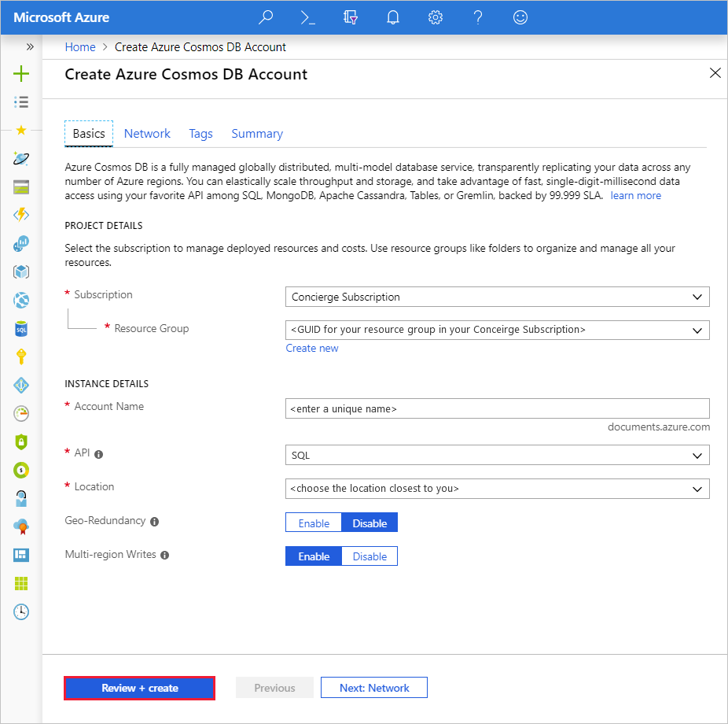
Provisioning Cosmos DB
Notes:
Instructor notes
You can provision a Cosmos DB account interactively using the Azure portal, or you can perform this task programmatically through the Azure CLI, Azure PowerShell, or an Azure Resource Manager template.

Slide 105
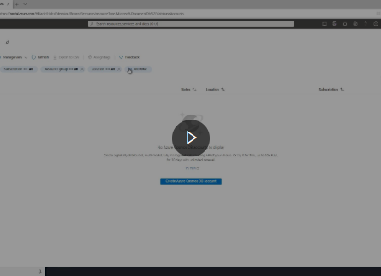
Demo: How to provision a Cosmos DB account
You can provision a Cosmos DB account interactively using the Azure portal, or you can perform this task programmatically through the Azure CLI, Azure PowerShell, or an Azure Resource Manager template. This video describes how to use the Azure portal
Notes:
Instructor notes
Link: https://www.microsoft.com/videoplayer/embed/RE4AwNK

Slide 106
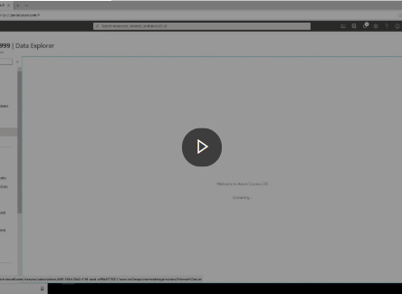
Demo
Use the Azure portal to create a database and container
Notes:
Instructor notes
Link: https://www.microsoft.com/videoplayer/embed/RE4AkhH

Slide 107
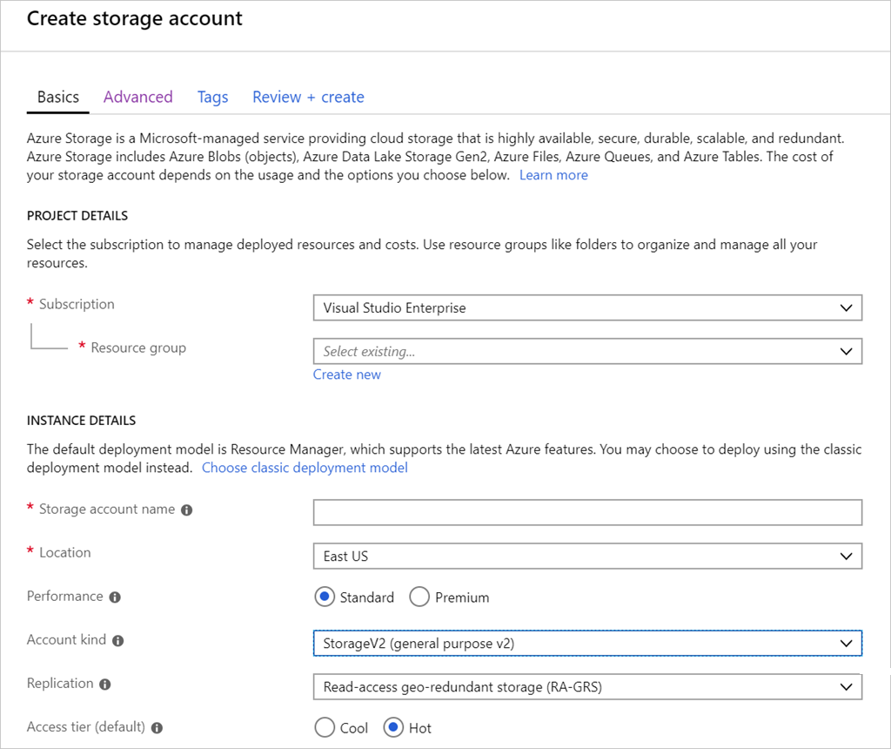
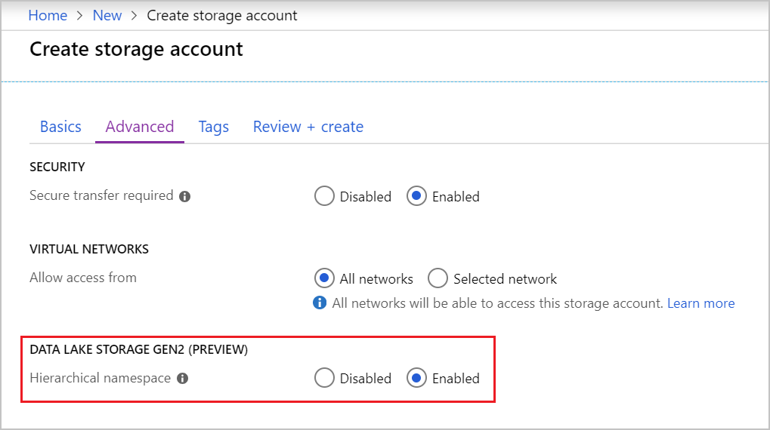
Provisioning Data Lake storage
Notes:
Instructor notes
IMPORTANT: If you're provisioning a Data Lake storage, you must specify the appropriate configuration settings when you create the storage account. You can't configure Data Lake storage after the storage account has been set up.
In the Azure portal, on the Advanced tab of the Create storage account page, in the Data Lake Storage Gen2 section, select Enabled for the Hierarchical namespace option.
After the storage account has been created, you can add one or more Data Lake Storage containers to the account. Each container supports a directory structure for storing Data Lake files.

Slide 108
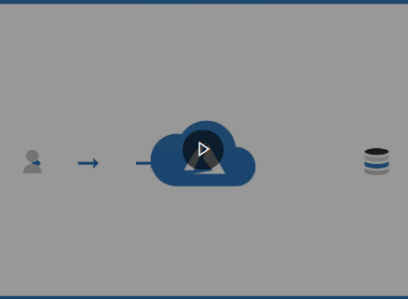
Demo: Azure authentication
Azure AD is a separate Azure service. You add users and other security principals (such as an application) to a security domain managed by Azure AD. This video describes how authentication works with Azure
Notes:
Instructor notes
Link: https://www.microsoft.com/videoplayer/embed/RE4A94T

Slide 109
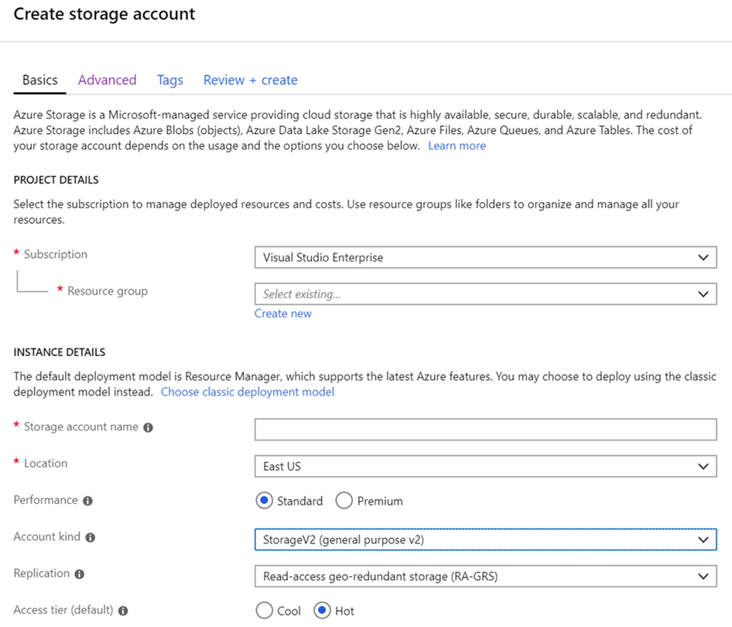
Configure storage accounts
Notes:
Instructor notes
The Configuration page for a storage account enables you to modify some general settings of the account. You can:
- Enable or disable secure communications with the service. By default, all requests and responses are encrypted by using the HTTPS protocol as they traverse the Internet. You can disable encryption if required, although this isn't recommended.
- Switch the default access tier between Cool and Hot.
- Change the way in which the account is replicated.
- Enable or disable integration with Azure AD for requests that access file shares.
Other options, such as the account kind and performance tier, are displayed on this page for information only; you can't change them.

Slide 110
Lesson 2: Knowledge check
What is provisioning?
The act of running series of tasks that a service provider performs to create and configure a service
Providing other users access to an existing service
Tuning a service to improve performance
What is a security principal?
A named collection of permissions that can be granted to a service, such as the ability to use the service to read, write, and delete data. In Azure, examples include Owner and Contributor.
A set of resources managed by a service to which you can grant access
An object that represents a user, group, service, or managed identity that is requesting access to Azure resources
Which of the following is an advantage of using multi-region replication with Cosmos DB?
Data will always be consistent in every region
Availability is increased
Increased security for your data

Slide 111

Lesson 3: Manage non-relational data stores in Azure

Slide 112

Lesson 3 objectives
Upload data to a Cosmos DB database, and learn how to query this data
Upload and download data in an Azure Storage account
Notes:
Instructor notes
Ensure that all of your students fully understand the components and processes involved. This will be the focus of the module.

Slide 113
Cosmos DB APIs
SQL API
MongoDB API
Cassandra API
Gremlin API
Table API
Notes:
Cosmos DB also provides other APIs that enable you to access these documents using the command sets of other NoSQL database management systems.
These APIs are:
Table API. This interface enables you to use the Azure Table Storage API to store and retrieve documents. The purpose of this interface is to enable you to switch from Table Storage to Cosmos DB without requiring that you modify your existing applications.
MongoDB API. MongoDB is another well-known document database, with its own programmatic interface. Many organizations use on-premises. You can use the MongoDB API for Cosmos DB to enable a MongoDB application to run unchanged against a Cosmos DB database. You can migrate the data in the MongoDB database to Cosmos DB running in the cloud, but continue to run your existing applications to access this data.
Cassandra API. Cassandra is a column family database management system. This is another database management system that many organizations run on-premises. The Cassandra API for Cosmos DB provides a Cassandra-like programmatic interface for Cosmos DB. Cassandra API requests are mapped to Cosmos DB document requests. As with the MongoDB API, the primary purpose of the Cassandra API is to enable you to quickly migrate Cassandra databases and applications to Cosmos DB.
Gremlin API. The Gremlin API implements a graph database interface to Cosmos DB. A graph is a collection of data objects and directed relationships. Data is still held as a set of documents in Cosmos DB, but the Gremlin API enables you to perform graph queries over the data. Using the Gremlin API you can walk through the objects and relationships in the graph to discover all manner of complex relationships, such as "What is the name of the pet of Sam's landlord?“.
The principal use of the Table, MongoDB, and Cassandra APIs is to support existing applications written using these data stores. If you're building a new application and database, you should use the SQL API or Gremlin API.

Slide 114
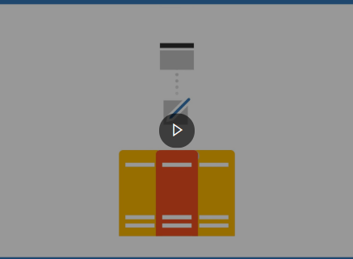
Demo: Configure consistency
Within a single region, Cosmos DB uses a cluster of servers. This approach helps to improve scalability and availability. A copy of all data is held in each server in the cluster. This video explains how this works, and the effects it can have on consistency
Notes:
Instructor notes
Link: https://www.microsoft.com/videoplayer/embed/RE4AbG9

Slide 115
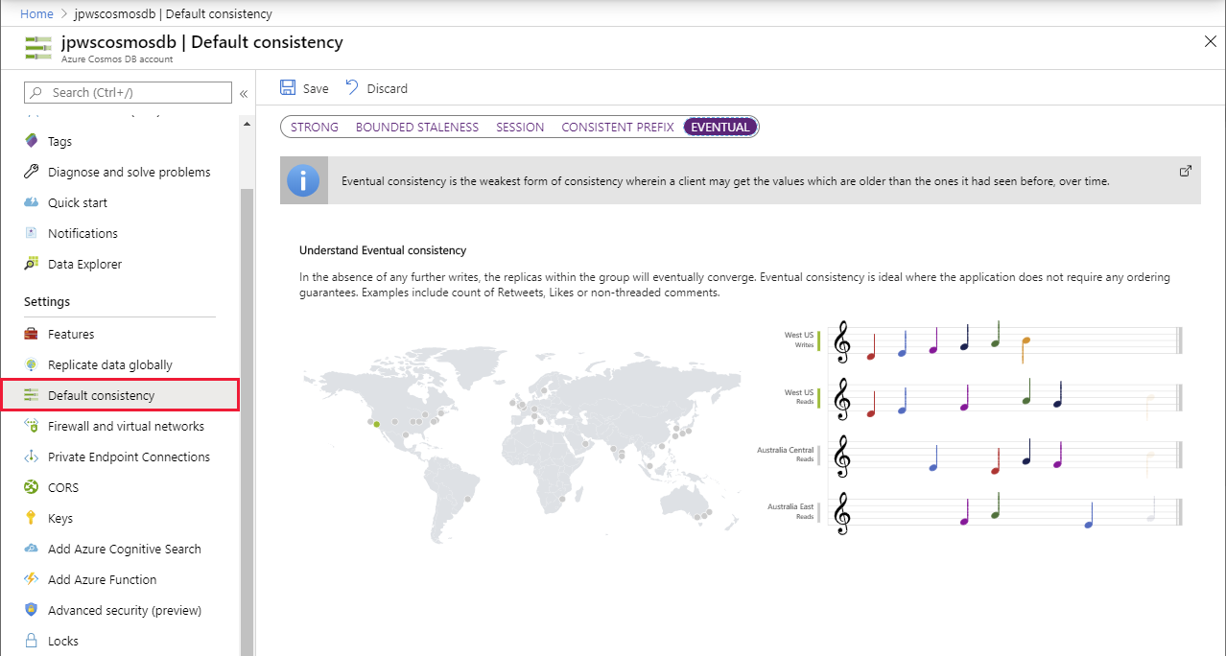
Consistency in Azure Cosmos DB
Notes:
Cosmos DB enables you to specify how such inconsistencies should be handled. It provides the following options:
Eventual. This option is the least consistent. It's based on the situation just described. Changes won't be lost, they'll appear eventually, but they might not appear immediately. Additionally, if an application makes several changes, some of those changes might be immediately visible, but others might be delayed; changes could appear out of order.
Consistent Prefix. This option ensures that changes will appear in order, although there may be a delay before they become visible. In this period, applications may see old data.
Session. If an application makes a number of changes, they'll all be visible to that application, and in order. Other applications may see old data, although any changes will appear in order, as they did for the Consistent Prefix option. This form of consistency is sometimes known as read your own writes.
Bounded Staleness. There's a lag between writing and then reading the updated data. You specify this staleness either as a period of time, or number of previous versions the data will be inconsistent for.
Strong: In this case, all writes are only visible to clients after the changes are confirmed as written successfully to all replicas. This option is unavailable if you need to distribute your data across multiple global regions.

Slide 116
Query Azure Cosmos DB
COUNT( <fields_to_count> )
SUM( <numeric_fields> )
AVG( <numeric_fields> )
MAX( <numeric_fields> )
MIN( <numeric_fields> )
Aggregation Function Basics
SQL API examples
SELECT COUNT(*) FROM Products p
SELECT SUM(p.quantity) FROM Products p
WHERE p.expired = 0
SELECT AVG(p.price) AS ‘Average Price’
FROM Products p
SELECT p1.ID, p.Name, p1.Description, p1.Price FROM Products p1
WHERE p1.Price = (SELECT MIN(p2.Price) FROM Product p2)
Notes:
Instructor notes
Understand aggregate functions
You can use aggregate functions to summarize data in SELECT queries; you place aggregate functions in the SELECT clause. The SQL API query language supports the following aggregate functions:
COUNT(p). This function returns a count of the number of instances of field p in the result set. To count all the items in the result set, set p to a scalar value, such as 1.
SUM(p). This function returns the sum of all the instances of field p in the result set. The values of p must be numeric.
AVG(p). This function returns the mathematical mean of all the instances of field p in the result set. The values of p must be numeric.
MAX(p). This function returns the maximum value of field p in the result set.
MIN(p). This function returns the minimum value of field p in the result set.
Although the syntax of aggregate functions is similar to ANSI SQL, unlike ANSI SQL the SQL API query language doesn't support the GROUP BY clause; you can't generate subtotals for different values of the same field in a single query. You're able to include more than one aggregate function in the SELECT clause of your queries.
[Demo with the Volcanoes Data]
// Find the total number of volcanoes in Japan
SELECT COUNT(v) AS totalVolcanoesJapan
FROM v
WHERE v.Region = "Japan“
// Find the deepest volcano in Japan
SELECT MAX(v.Elevation) AS deepestVolcanoJapan
FROM v
WHERE v.Region = "Japan"

Slide 117
Lab: Upload, download, and query data in a non-relational data store
Go to the exercise Upload, download, and query data in a non-relational data store module on Microsoft Learn, and follow the instructions in the module
Notes:
Link: https://docs.microsoft.com/en-us/learn/modules/explore-non-relational-data-stores-azure/6-exercise
Instructor notes
In the sample scenario, suppose that you've created the following data stores:
A Cosmos DB for holding information about the products that Contoso manufactures.
A blob container in Azure Storage for holding the images of products.
A file share, in the same Azure Storage account, for holding product documentation.
In this exercise, you'll upload data to these data stores. You'll run queries against the data in the Cosmos DB database. Finally, you'll download and view the images and documents held in Azure Storage.
You'll perform this exercise using the Azure portal and the command line.

Slide 118
Closing slide

Slide 119
Module 4: Explore modern data warehouse analytics

Slide 120



Agenda
Examine components of a modern data warehouse
Explore large-scale data analytics
Get started building with Power BI

Slide 121
Lesson 1: Examine components of a modern data warehouse

Slide 122
Lesson 1 objectives
Explore data warehousing concepts
Explore Azure data services for modern data warehousing
Explore modern data warehousing architecture and workload
Explore Azure data services in the Azure portal
Notes:
Instructor notes
Ensure that all of your students fully understand the components and processes involved. This will be the focus of the module.

Slide 123
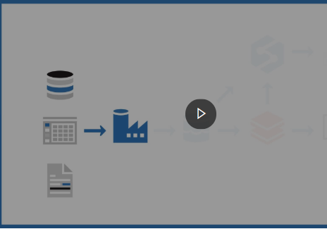
Demo: Modern data warehouse components
This video describes the components commonly used to create a data warehouse, and how data might flow through them. This video shows one particular approach
Notes:
Link: https://www.microsoft.com/videoplayer/embed/RE4A3RR

Slide 124
Azure services for the modern data warehouse
Azure Data Factory
Azure Data Lake
Azure Databricks
Azure HDInsight
Azure Synapse
Analytics
Notes:
Instructor notes
Azure Data Factory is a service that can ingest large amounts of raw, unorganized data from relational and non-relational systems, and convert this data into meaningful information.
Data Factory provides a scalable and programmable ingestion engine that you can use to implement complex hybrid extract-transform-load (ETL), extract-load-transform (ELT), and data integration projects.
Azure Data Lake is a collection of analytics and storage services that you can combine to implement a big data solution. It comprises three main elements: - Data Lake Store
- Data Lake Analytics
- HDInsight
Azure Databricks is an analytics platform optimized for the Microsoft Azure cloud services platform.
Designed with the founders of Apache Spark, Databricks is integrated with Azure to provide one-click setup, streamlined workflows, and an interactive workspace that enables collaboration between data scientists, data engineers, and business analysts.
Azure Synapse Analytics is generalized analytics service. You can use it to read data from many sources, process this data, generate various analyses and models, and save the results.
Azure HDInsight is a managed analytics service in the cloud. It's based on Apache Hadoop, a collection of open-source tools and utilities that enable you to run processing tasks over large amounts of data. HDInsight uses a clustered model, similar to that of Synapse Analytics.
HDInsight stores data using Azure Data Lake storage.
You can use HDInsight to analyze data using frameworks such as Hadoop Map/Reduce, Apache Spark, Apache Hive, Apache Kafka, Apache Storm, R, and more.

Slide 125
What is Azure Data Factory?
Azure Data Factory is described as a data integration service.
Retrieves data from more than one data source and converts it.
Filters out noise to keep interesting data
Work is defined as a pipeline operation – runs continuously as data is received
Notes:
Azure Data Factory is a service that can ingest large amounts of raw, unorganized data from relational and non-relational systems, and convert this data into meaningful information. Data Factory provides a scalable and programmable ingestion engine that you can use to implement complex hybrid extract-transform-load (ETL), extract-load-transform (ELT), and data integration projects.
Using Azure Data Factory, you can create and schedule data-driven workflows (called pipelines) that can ingest data from the disparate data stores used by the gaming company. You can build complex ETL processes that transform data visually with data flows or by using compute services such as Azure HDInsight, Azure Databricks, and Azure SQL Database. You can then publish the transformed data to Azure Synapse Analytics for business intelligence applications to consume.

Slide 126
What is Azure Data Lake Storage?
Azure Data Lake Storage is a repository of data for your modern data warehouse.
Organizes data into directories for improved file access.
Supports POSIX and RBAC permissions.
Compatible with the Hadoop Distributed File System
Notes:
Data Lake Storage organizes your files into directories and subdirectories for improved file organization. Blob storage can only mimic a directory structure.
Azure Data Lake Store provides granular security over data, using Access Control Lists. An Access Control List specifies which accounts can access which files and folders in the store. If you are more familiar with Linux, you can use POSIX (Portable Operating System Interface)-style permissions to grant read, write, and search access based on file ownership and group membership of users
Also, you can use directory permissions to enable granular Role-Based Access Control (RBAC) on your data.
Azure Data Lake Storage is compatible with the Hadoop Distributed File System (HDFS). Hadoop is highly flexible and programmable analysis service, used by many organizations to examine large quantities of data. All Apache Hadoop environments can access data in Azure Data Lake Storage Gen2.

Slide 127
What is Azure Databricks?
Azure Databricks is an Apache Spark-based platform that provides big data processing and streaming.
Simplifies the provisioning and collaboration of Apache spark-based analytical solutions.
Utilizes the security capabilities of Azure.
Integrates with a variety of Azure data platform services and Power BI.
Notes:
Instructor notes
Azure Databricks is an analytics platform optimized for the Microsoft Azure cloud services platform. Designed with the founders of Apache Spark, Databricks is integrated with Azure to provide one-click setup, streamlined workflows, and an interactive workspace that enables collaboration between data scientists, data engineers, and business analysts.
Apache Spark is a highly efficient data processing engine that can consume and process large amounts of data very quickly. There are a significant number of Spark libraries you can use to perform tasks such as SQL processing, aggregations, and to build and train machine learning models using your data.
Azure Databricks provides a graphical user interface where you can define and test your processing step by step, before submitting it as a set of batch tasks. You can create Databricks scripts and query data using languages such as R, Python, and Scala. You write your Spark code using notebooks. A notebook contains cells, each of which contains a separate block of code. When you run a notebook, the code in each cell is passed to Spark in turn for execution.

Slide 128
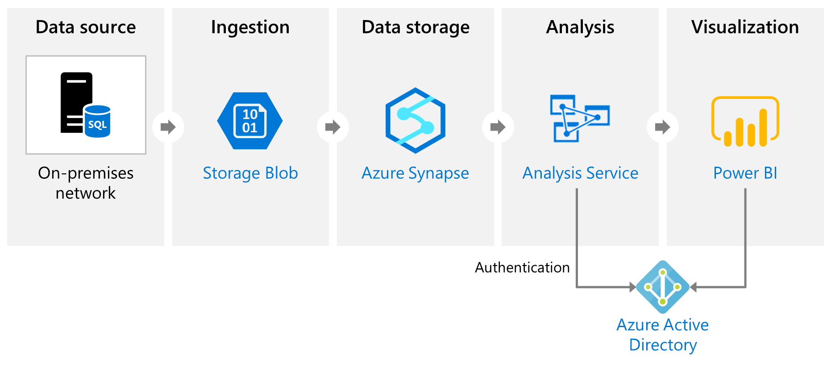
What is Azure Analysis Services?
Azure Analysis Services builds tabular models to support online analytical processing (OLAP) queries. It can combine data from multiple sources, including Azure SQL Database, Azure Synapse Analytics, Azure Data Lake Store, Azure Cosmos DB and others.
Notes:
Instructor notes
Azure Analysis Services enables you to build tabular models to support online analytical processing (OLAP) queries. You can combine data from multiple sources, including Azure SQL Database, Azure Synapse Analytics, Azure Data Lake store, Azure Cosmos DB, and many others. You use these data sources to build models that incorporate your business knowledge.
Analysis Services includes a graphical designer to help you connect data sources together and define queries that combine, filter, and aggregate data. You can explore this data from within Analysis Services, or you can use a tool such as Microsoft Power BI to visualize the data presented by these models.

Slide 129
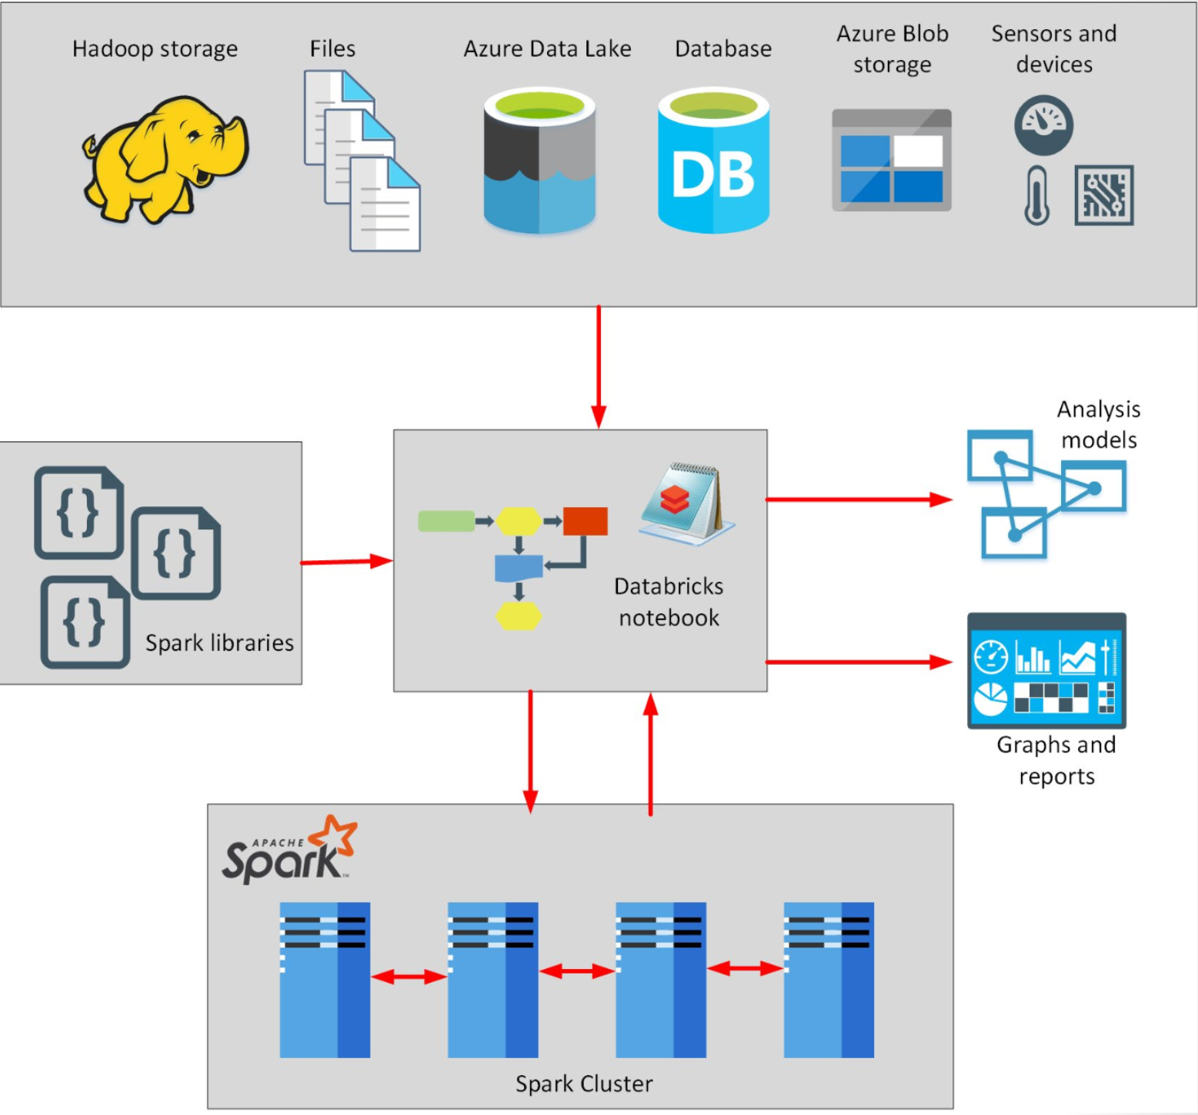
What is Azure HDInsight?
Azure HDInsight is a big data processing services which allows you to use open-source libraries on the one platform, in an Azure environment.
Notes:
Instructor notes
Azure HDInsight is a managed analytics service in the cloud. It's based on Apache Hadoop, a collection of open-source tools and utilities that enable you to run processing tasks over large amounts of data. HDInsight uses a clustered model, similar to that of Synapse Analytics. HDInsight stores data using Azure Data Lake storage. You can use HDInsight to analyze data using frameworks such as Hadoop Map/Reduce, Apache Spark, Apache Hive, Apache Kafka, Apache Storm, R, and more.

Slide 130

Lesson 1: Knowledge check
When should you use Azure Synapse Analytics?
To perform very complex queries and aggregations
To create dashboards from tabular data
To enable large number of users to query analytics data
What is the purpose of data ingestion?
To perform complex data transformations over data received from external sources
To capture data flowing into a data warehouse system as quickly as possible
To visualize the results of data analysis
What is the primary difference between a data lake and a data warehouse?
A data lake contains structured information, but a data warehouse holds raw business data
A data lake holds raw data, but a data warehouse holds structured information
Data stored in a data lake is dynamic, but information stored in a data warehouse is static

Slide 131
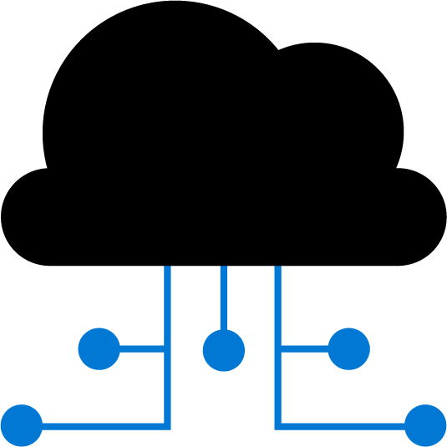
Lesson 2: Explore large-scale data analytics

Slide 132
Lesson 2 objectives
Describe data ingestion in Azure
Describe components of Azure Data Factory
Describe data processing options for performing analytics in Azure
See how to use Azure Data Factory to load data into a data warehouse
Explore Azure Synapse Analytics
Notes:
Instructor notes
Ensure that all of your students fully understand the components and processes involved. This will be the focus of the module.

Slide 133
Describe data ingestion in Azure
ADF
PolyBase
SSIS
70
100
80
Heterogenous
File based
Heterogenous
Notes:
Instructor notes
Azure Data Factory is a data ingestion and transformation service that allows you to load raw data from many different sources, both on-premises and in the cloud.
As it ingests the data, Data Factory can clean, transform, and restructure the data, before loading it into a repository such as a data warehouse. Once the data is in the data warehouse, you can analyze it.
PolyBase is a feature of SQL Server and Azure Synapse Analytics that enables you to run Transact-SQL queries that read data from external data sources. PolyBase makes these external data sources appear like tables in a SQL database.
Using PolyBase, you can read data managed by Hadoop, Spark, and Azure Blob Storage, as well as other database management systems such as Cosmos DB, Oracle, Teradata, and MongoDB.
SQL Server Integration Services (SSIS) is a platform for building enterprise-level data integration and data transformations solutions.
You can use SSIS to solve complex business problems by copying or downloading files, loading data warehouses, cleaning and mining data, and managing SQL database objects and data. SSIS is part of Microsoft SQL Server.
Databricks can process data held in many different types of storage, including Azure Blob storage, Azure Data Lake Store, Hadoop storage, flat files, SQL databases, and data warehouses, and Azure services such as Cosmos DB. Databricks can also process streaming data. For example, you could capture data being streamed from sensors and other devices.

Slide 134


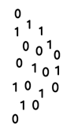


Describe components of Azure Data Factory
Linked Service
Triggers
@
Parameters
IR
Integration Runtime
Data Lake Store
Pipeline
CF
Control Flow
1
Activities
Azure Databricks
Dataset
Notes:
Instructor notes
Azure Data Factory can incorporate Azure Databricks notebooks into a pipeline. A pipeline can pass parameters to a notebook. These parameters can specify which data to read and analyze. The notebook can save the results, which the Azure Data Factory pipeline can use in subsequent activities.

Slide 135
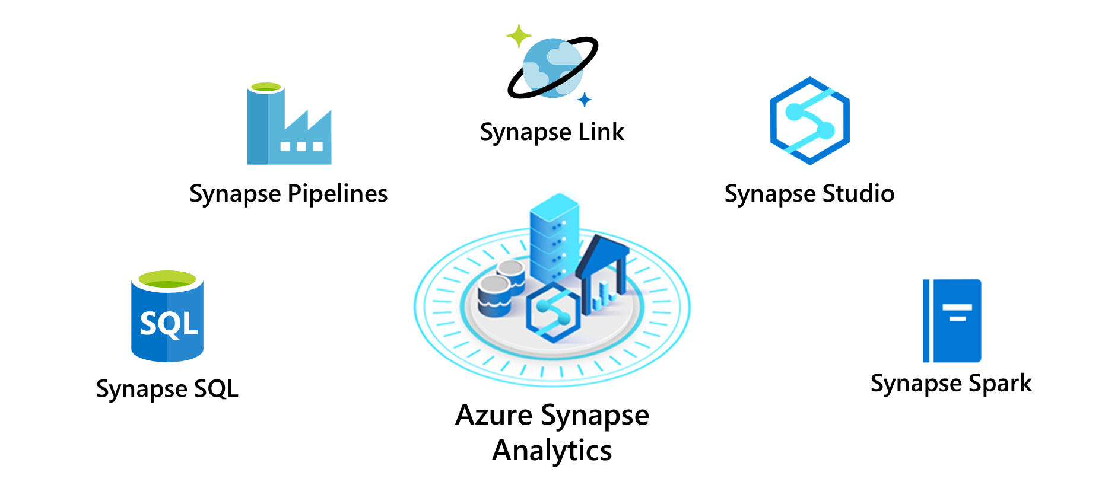
Explore Azure Synapse Analytics
Notes:
Instructor notes
- Synapse SQL pool: This is a collection of servers running Transact-SQL. Transact-SQL is the dialect of SQL used by Azure SQL Database, and Microsoft SQL Server. You write your data processing logic using Transact-SQL.
- Synapse Spark pool: This is a cluster of servers running Apache Spark to process data.
You write your data processing logic using one of the four supported languages: Python, Scala, SQL, and C# (via .NET for Apache Spark). Spark pools support Azure Machine Learning through integration with the SparkML and AzureML packages.
- Synapse Pipelines: A Synapse pipeline is a logical grouping of activities that together perform a task.
The activities in a pipeline define actions to perform on your data. For example, you might use a copy activity to transform data from a source dataset to a destination dataset. You could include activities that transform the data as it is transferred, or you might combine data from multiple sources together.
- Synapse Link: This component allows you to connect to Cosmos DB. You can use it to perform near real-time analytics over the operational data stored in a Cosmos DB database.
- Synapse Studio: This is a web user interface that enables data engineers to access all the Synapse Analytics tools. You can use Synapse Studio to create SQL and Spark pools, define and run pipelines, and configure links to external data sources.

Slide 136
Demo: Create an Azure Synapse Analytics workspace and analyze data
In this demo, we'll create a Synapse Analytics workspace and use it to ingest and analyze some data.
The demo is designed to familiarize you with some key capabilities of Synapse Analytics, not as a comprehensive guide to performing advanced data analysis. The exercise should take around 30 minutes to complete.
Notes:
Go to the exercise Provision non-relational Azure data services on Microsoft Learn and follow the instructions in the module to create data stores.
NOTE: To complete this exercise, you'll need a Microsoft Azure subscription. If you don't already have one, you can sign up for a free trial at https://azure.microsoft.com/free.
NOTE: Students can try this on their own on Learn (see Skillpipe materials), but will require their own Azure subscription to complete this exercise.

Slide 137
Lesson 2: Knowledge check
Which component of an Azure Data Factory can be triggered to run data ingestion tasks?
CSV File
Pipeline
Linked service
When might you use PolyBase?
To query data from external data sources from Azure SQL Database
To ingest streaming data using Azure Databricks
To orchestrate activities in Azure Data Factory
Which of these services can be used to ingest data into Azure Synapse Analytics?
Azure Data Factory
Power BI
Azure Active Directory

Slide 138
Lesson 2: Knowledge check (continued)
You have a large amount of data held in files in Azure Data Lake storage. You want to retrieve the data in these files and use it to populate tables held in Azure Synapse Analytics. Which processing option is most appropriate?
Use Azure Synapse Link to connect to Azure Data Lake storage and download the data
Synapse SQL pool
Synapse Spark pool
Which of the components of Azure Synapse Analytics allows you to train AI models using AzureML?
Synapse Studio
Synapse Pipelines
Synapse Spark
In Azure Databricks how do you change the language a cell uses?
The first line in the cell is %language. For example, %scala
Change the notebook language before writing the commands
Wrap the command in the cell with ##language##

Slide 139
Lesson 3: Get started building with Power BI

Slide 140
Lesson 4 objectives
Learn how Power BI services and applications work together
Explore how Power BI can make your business more efficient
Learn how to create compelling visuals and reports
Notes:
Instructor notes
Ensure that all of your students fully understand the components and processes involved. This will be the focus of the module.

Slide 141
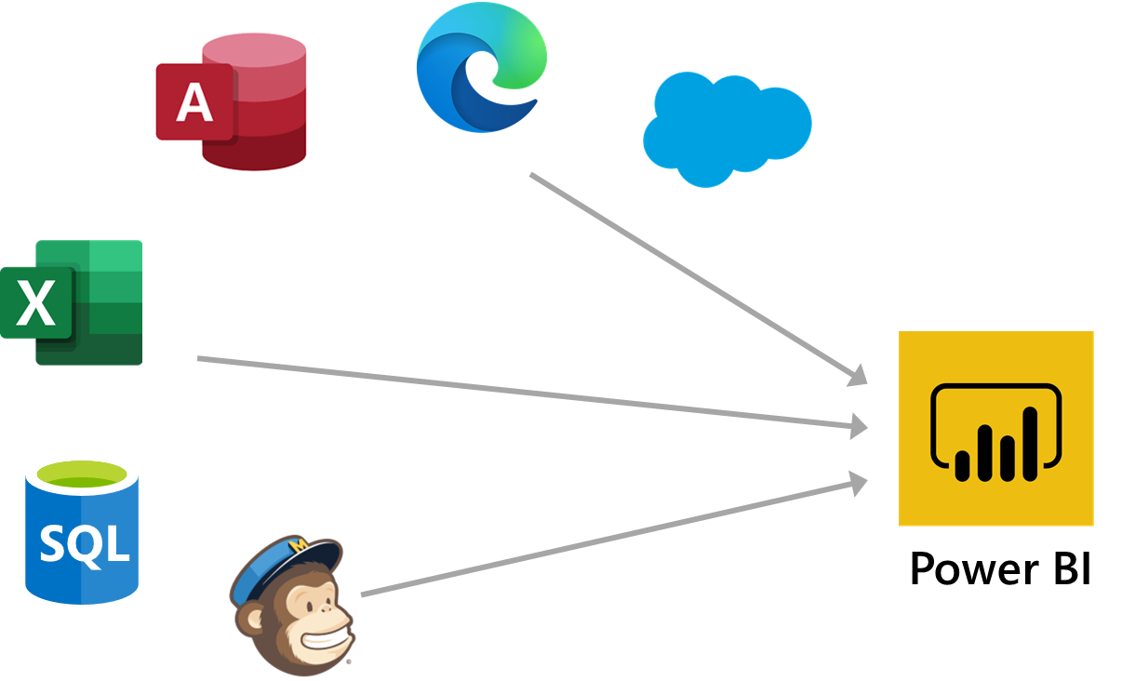
What is Power BI?
Notes:
Instructor notes
Here are the basic building blocks in Power BI:
* Visualizations
* Datasets
* Reports
* Dashboards
* Tiles
1. Bring data into Power BI Desktop as a dataset and create a report.
2. Publish to the Power BI service, where you can create new tiles and visualizations or build dashboards.
3. Share dashboards with others, especially people who are on the go.
4. View and interact with shared dashboards and reports in Power BI Mobile apps.

Slide 142
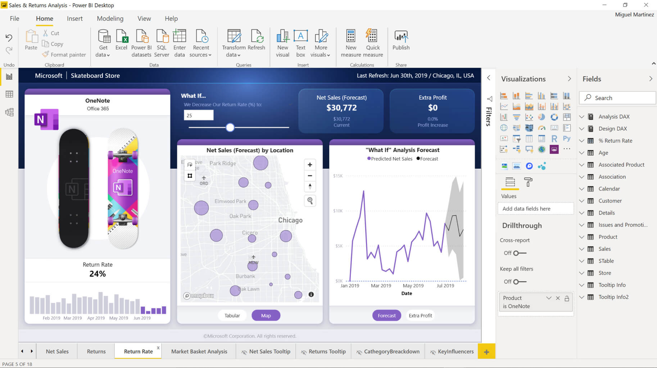
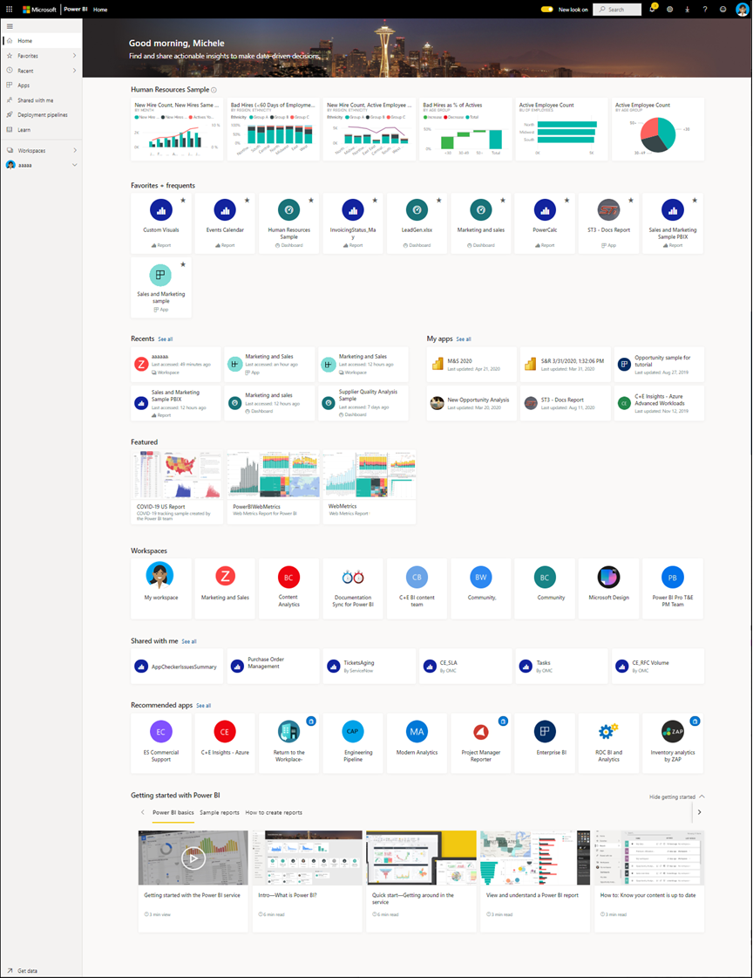
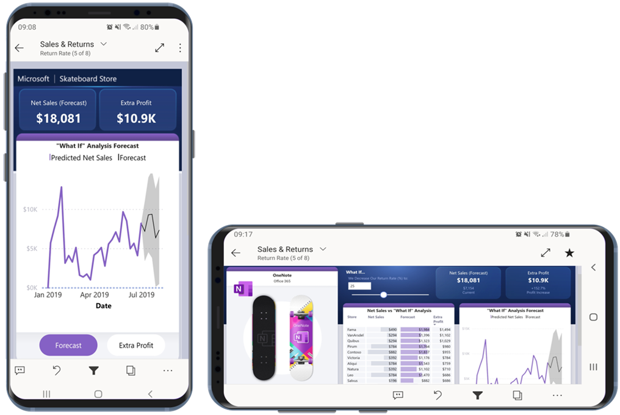
How can you use Power BI?
Power BI Desktop
Power BI Service
Animated Slide
Power BI Mobile
Notes:
Instructor notes
There are a few elements of Power BI, with three being:
The windows application called ‘Power BI Desktop’
The Online SaaS Service called ‘Power BI Service’
The Power BI apps for Windows, iOS and Android.
There is also the Power BI Report Builder, to create reports to share via the Power BI Service
and the Power BI Report Server, an on-prem server where you can publish your Power BI reports after creating it via Power BI Desktop

Slide 143
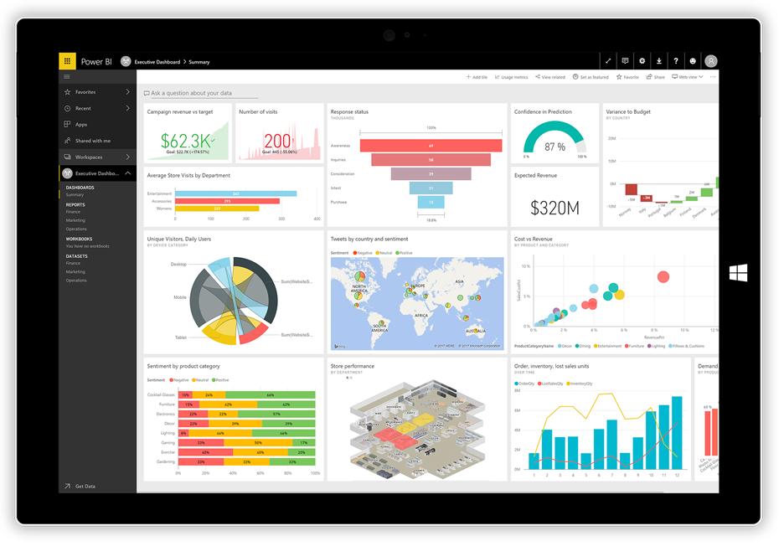
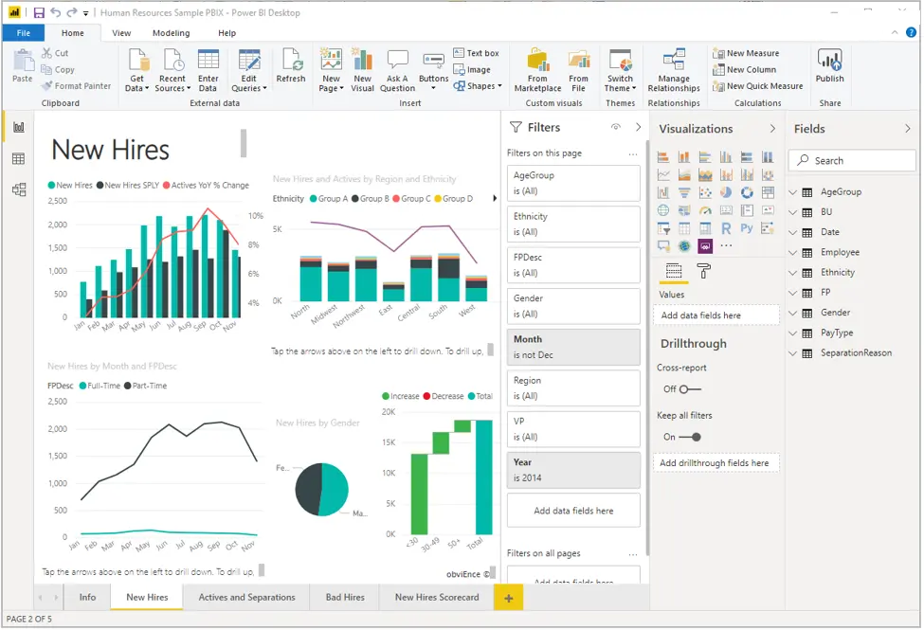
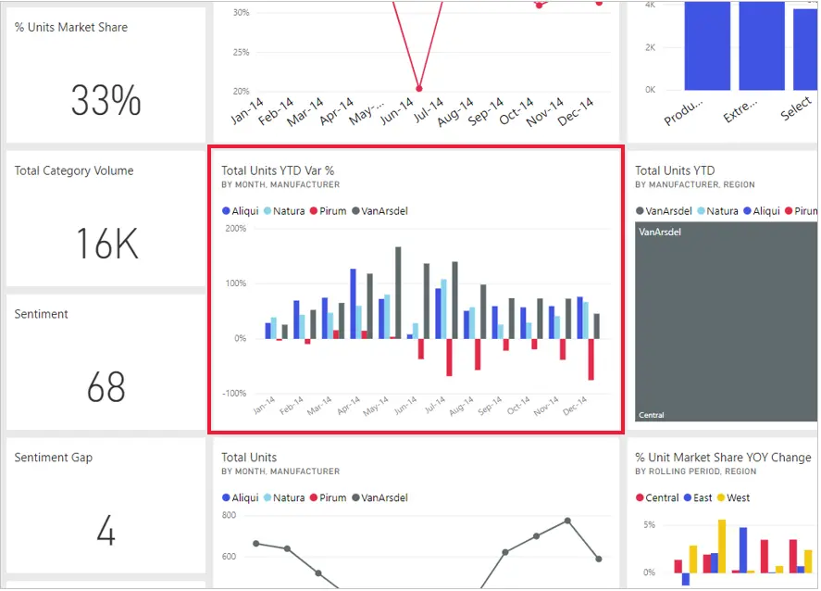
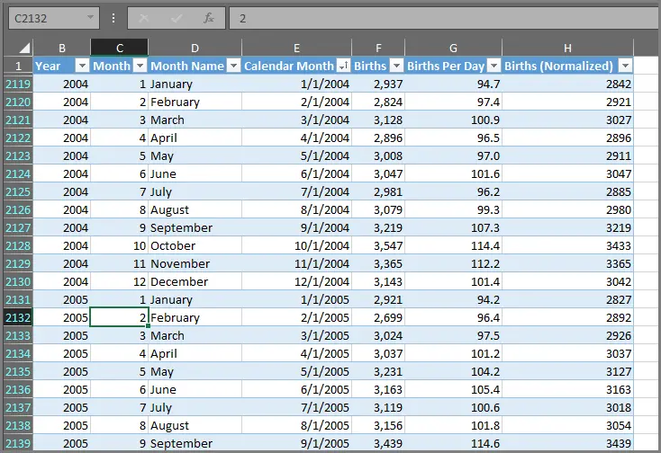
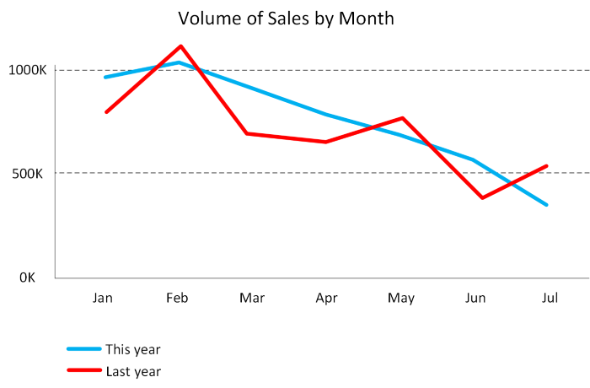
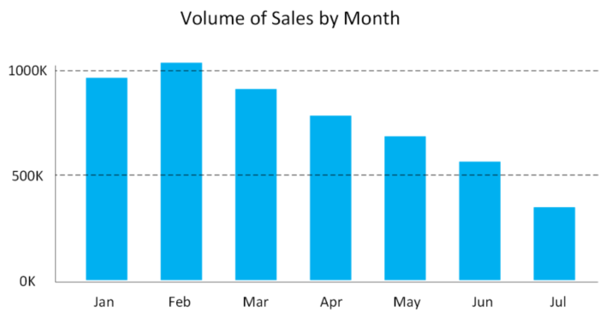
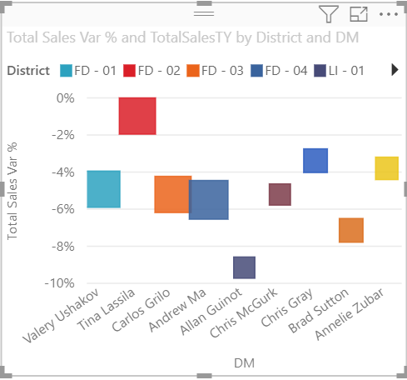
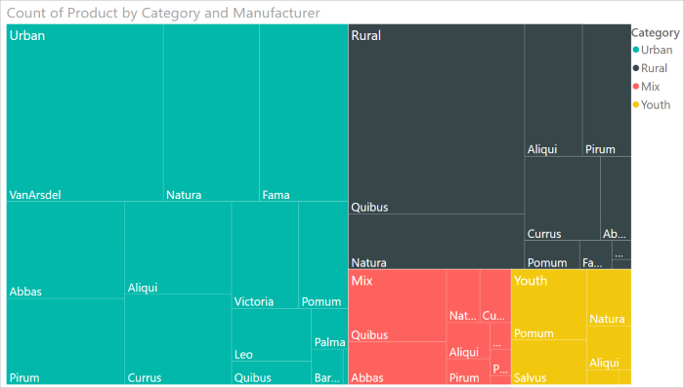


The anatomy of a Power BI app
Visualizations
Datasets
Reports
Dashboards
Animated Slide
Tiles
Notes:
Visualization (sometimes also referred to as a visual) is a visual representation of data, like a chart, a color-coded map, or other interesting things you can create to represent your data visually. Power BI has all sorts of visualization types, and more are coming all the time.
A dataset is a collection of data that Power BI uses to create its visualizations. Datasets can also be a combination of many different sources, which you can filter and combine to provide a unique collection of data (a dataset) for use in Power BI.
In Power BI, a report is a collection of visualizations that appear together on one or more pages. Just like any other report you might create for a sales presentation or write for a school assignment, a report in Power BI is a collection of items that are related to each other.
When you're ready to share a single page from a report, or a collection of visualizations, you create a dashboard. Much like the dashboard in a car, a Power BI dashboard is a collection of visuals from a single page that you can share with others. Often, it's a selected group of visuals that provide quick insight into the data or story you're trying to present.
In Power BI, a tile is a single visualization on a report or a dashboard. It's the rectangular box that holds an individual visual. In the following image, you see one tile, which is also surrounded by other tiles.

Slide 144
Lesson 4: Knowledge check
What is the common flow of activity in Power BI?
Create a report in Power BI mobile, share it to the Power BI Desktop, view and interact in the Power BI service
Create a report in the Power BI service, share it to Power BI mobile, interact with it in Power BI Desktop
Bring data into Power BI Desktop and create a report, share it to the Power BI service, view and interact with reports and dashboards in the service and Power BI mobile
Bring data into Power BI mobile, create a report, then share it to Power BI Desktop
Which of the following are building blocks of Power BI?
Tiles, dashboards, databases, mobile devices
Visualizations, datasets, reports, dashboards, tiles
Visual Studio, C#, and JSON files
A collection of ready-made visuals, pre-arranged in dashboards and reports is called what in Power BI?
The canvas
Scheduled refresh
An app

Slide 145
Closing slide

